Slide 1
Chapter 11
Technology, Production, and Costs
Notes:
Welcome to Economics!
Does this work?

Slide 2
Technology The processes a firm uses to turn inputs into outputs of goods and services.
What does a business firm do?
INPUTS OUTPUTS
Technological change A change in the ability of a firm to produce a given level of output with a given quantity of inputs.

Slide 3
The Short Run and the Long Run in Economics
Short run The period of time during which at least one of a firm’s inputs is fixed.
Long run The period of time in which a firm can vary all its inputs, adopt new technology, and increase or decrease the size of its physical plant.
How long is the short-run? It varies firm to firm (and industry to industry).

Slide 4
The Difference between Fixed Costs and Variable Costs
Total cost The cost of all the inputs a firm uses in production.
Variable costs Costs that change as output changes.
Fixed costs Costs that remain constant as output changes.
Total Cost = Fixed Cost + Variable Cost

Slide 5
Implicit Costs versus Explicit Costs
Explicit cost A cost that involves spending money.
Implicit cost A nonmonetary opportunity cost.
Value of the business owner’s time
Value of the business owner’s money
Foregone Interest
Economic depreciation (difference between what the owner paid for her machinery and what she could sell it for now)

Slide 6
Implicit Costs versus Explicit Costs
Jill Johnson’s Pizza Restaurant Costs of per Year
Pizza dough, tomato sauce, and other ingredients | $20,000
Wages | 48,000
Interest payments on loan to buy pizza ovens | 10,000
Electricity | 6,000
Lease payment for store | 24,000
Foregone salary | 30,000
Foregone interest | 3,000
Economic depreciation | 10,000
Total | $151,000

Slide 7
Production function The relationship between the inputs employed by a firm and the maximum output it can produce with those inputs.
In the short run, what is true about the production function?
A first look at the relationship between production and costs
Average total cost Total cost divided by the quantity of output produced.

Slide 8
Short-Run Production and Cost at Jill Johnson’s Restaurant
QUANTITY OF WORKERS | QUANTITY OF PIZZA OVENS | QUANTITY OF PIZZAS PER WEEK | COST OF PIZZA OVENS (FIXED COST) | COST OF WORKERS (VARIABLE COST) | TOTAL COST OF PIZZAS PER WEEK | COST PER PIZZA (AVERAGE TOTAL COST)
0 | 2 | 0 | $800 | $0 | $800 | —
1 | 2 | 200 | 800 | 650 | 1,450 | $7.25
2 | 2 | 450 | 800 | 1,300 | 2,100 | 4.67
3 | 2 | 550 | 800 | 1,950 | 2,750 | 5.00
4 | 2 | 600 | 800 | 2,600 | 3,400 | 5.67
5 | 2 | 625 | 800 | 3,250 | 4,050 | 6.48
6 | 2 | 640 | 800 | 3,900 | 4,700 | 7.34

Slide 9
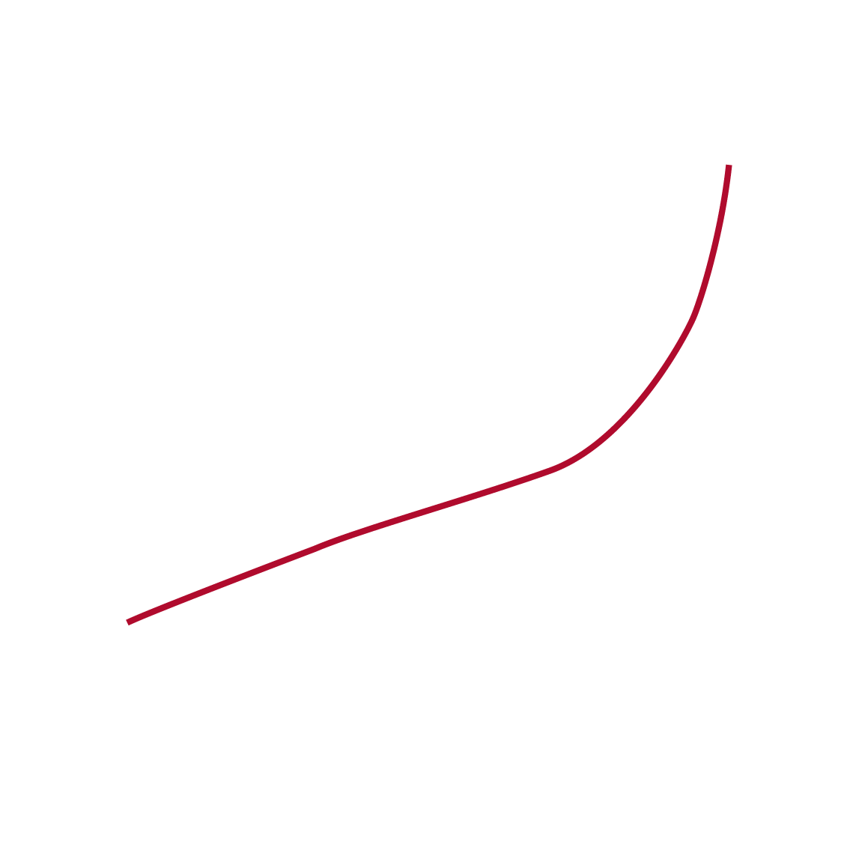
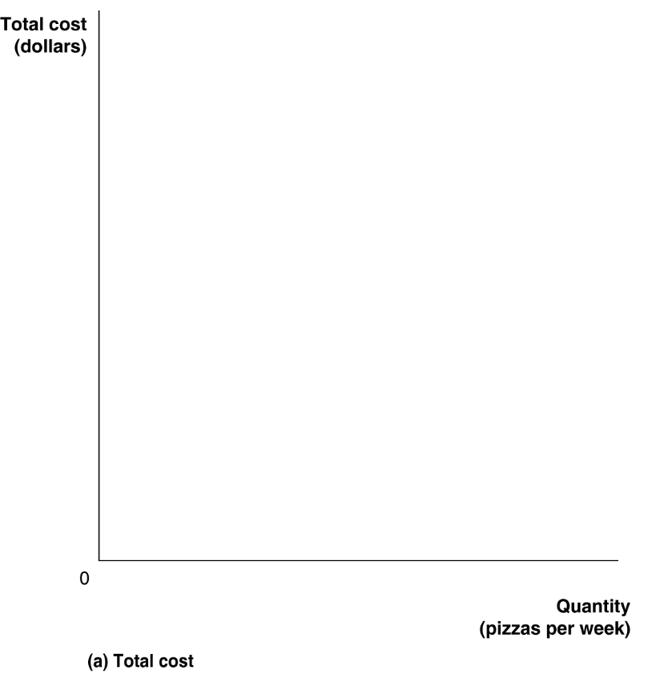
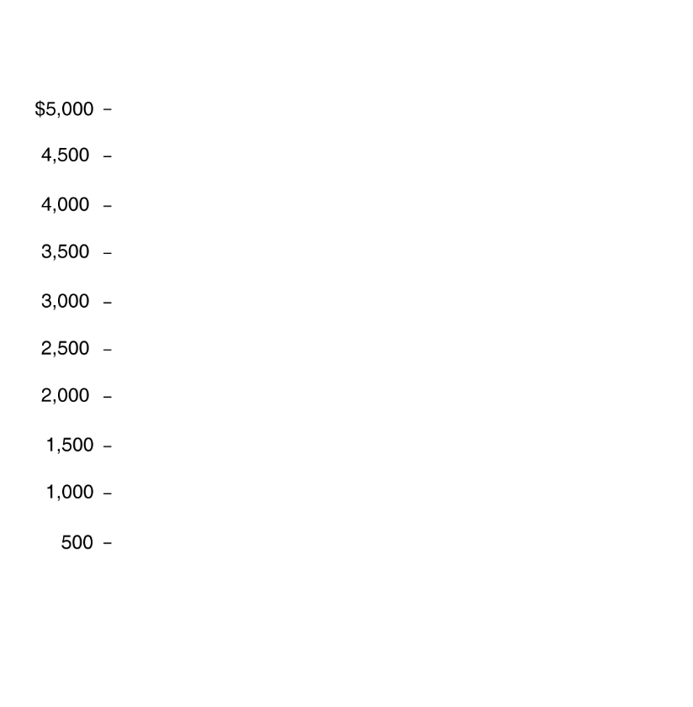
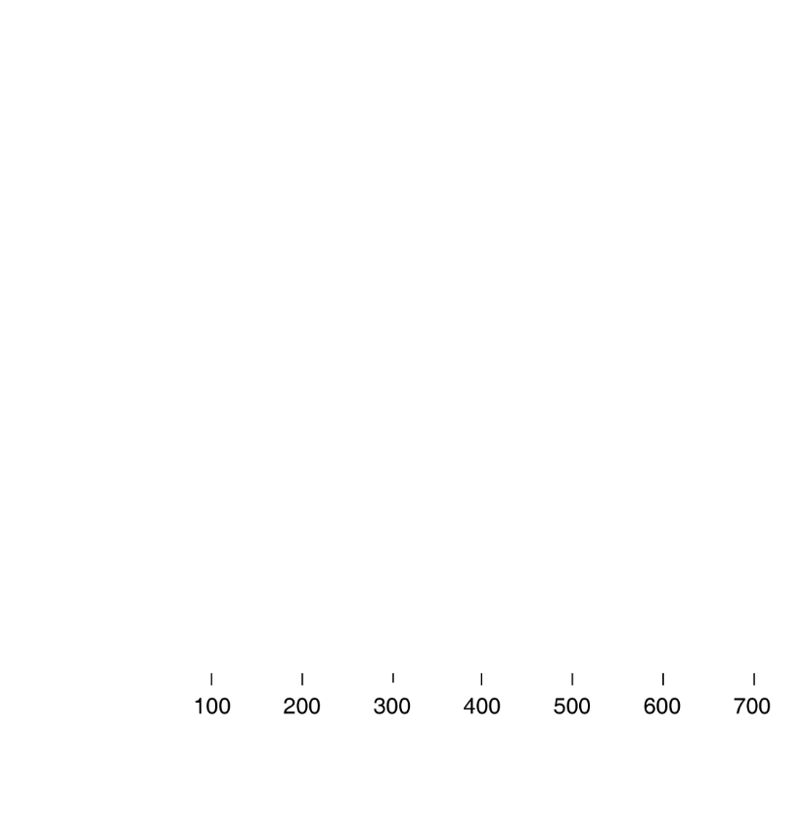
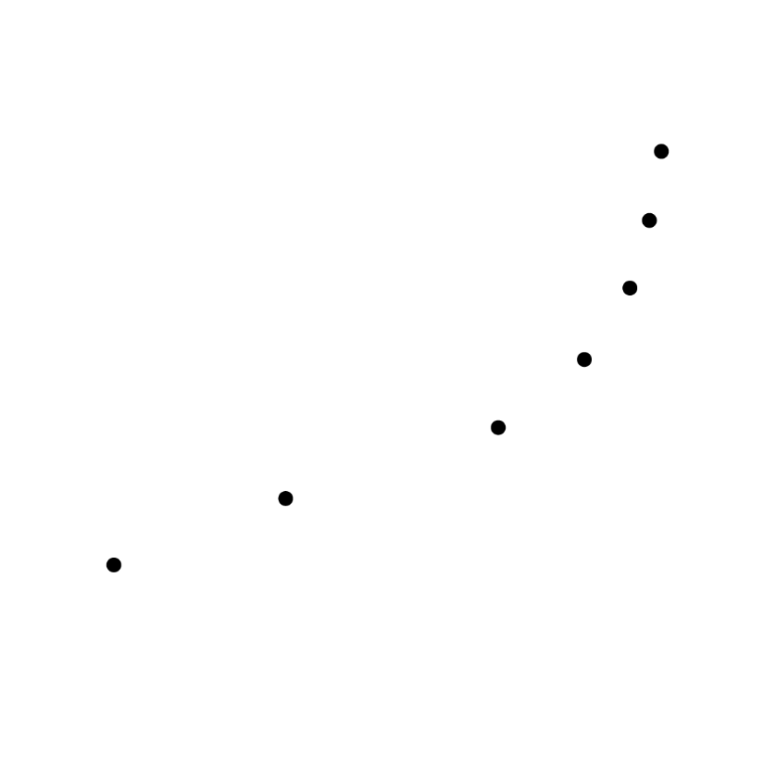
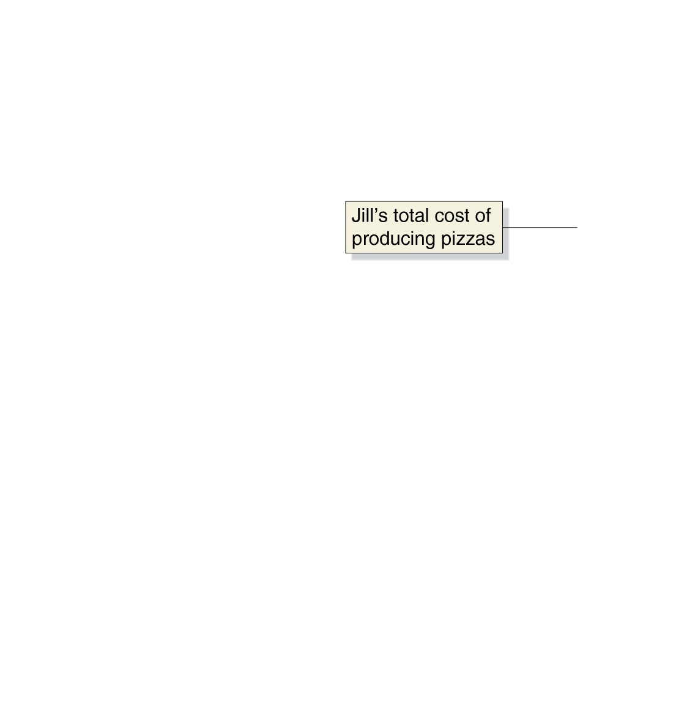

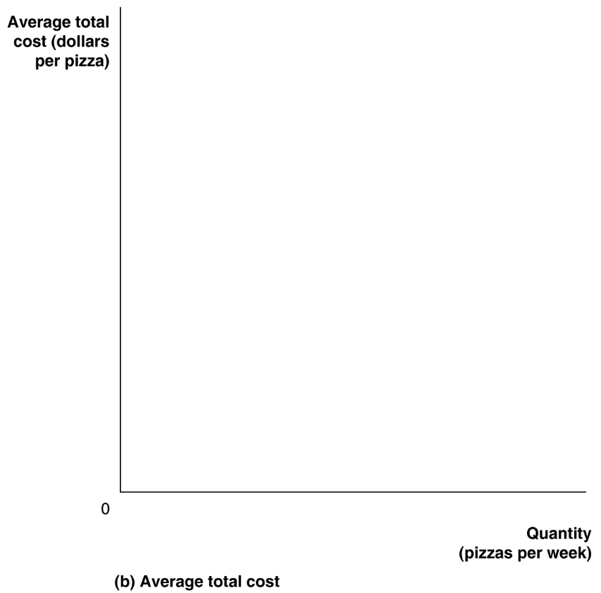
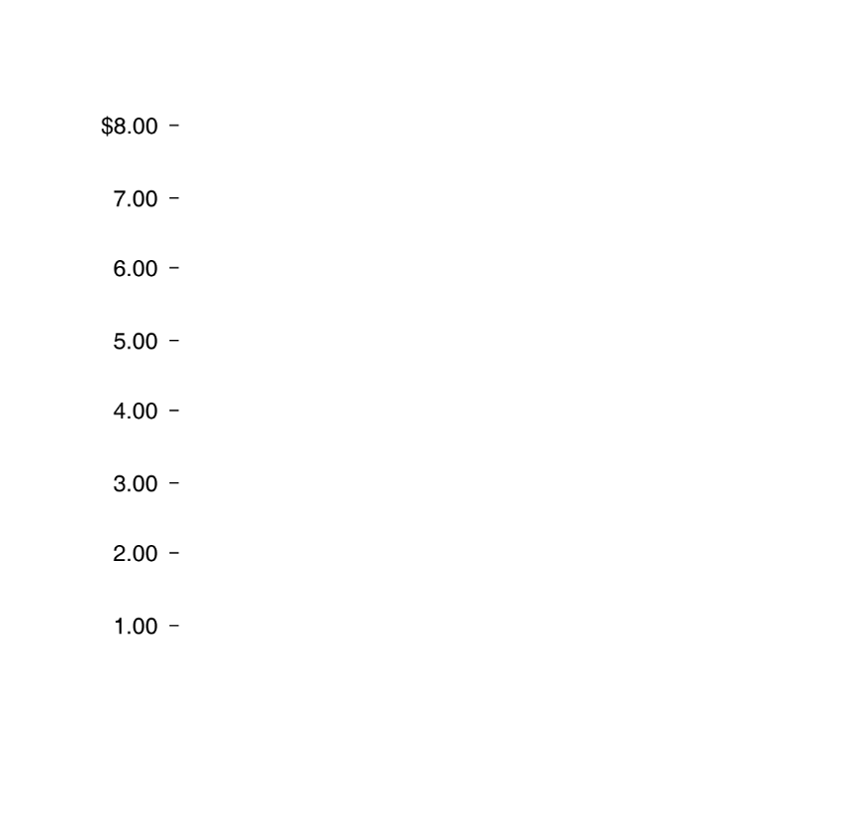
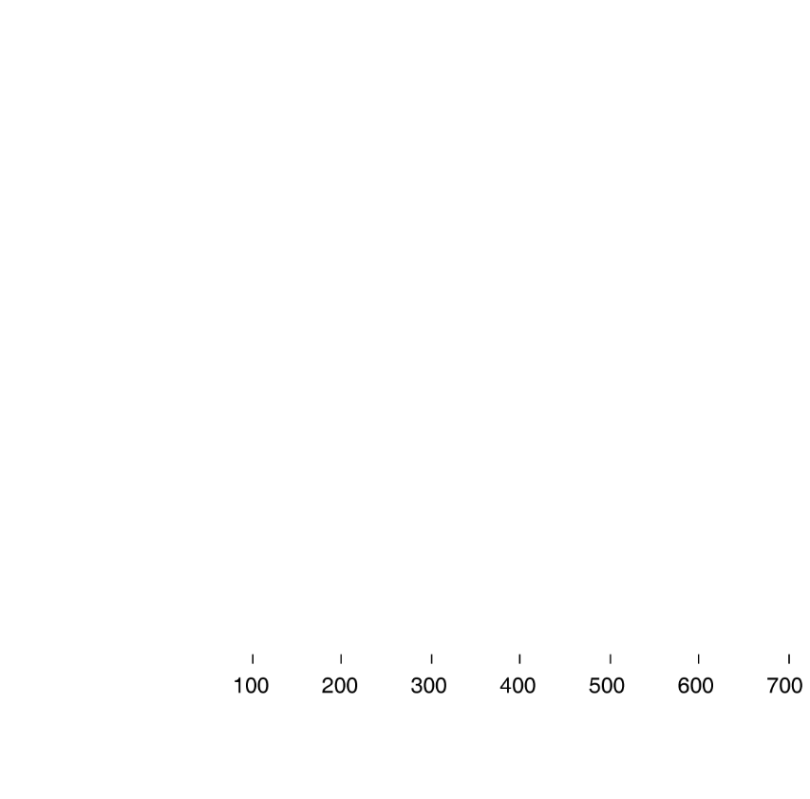

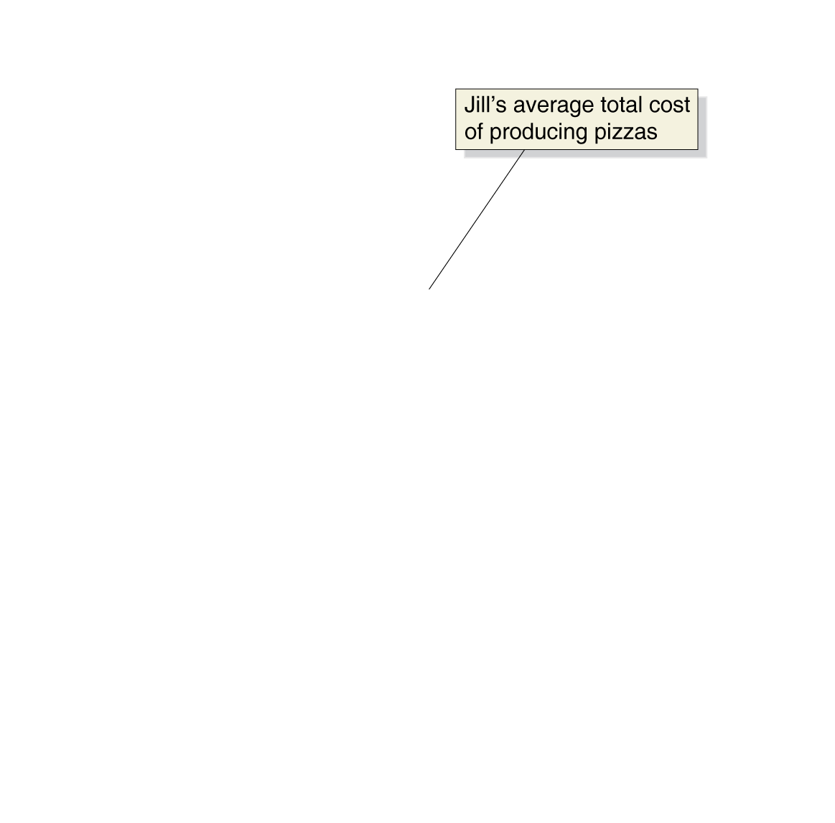
Graphing Total Cost and Average Total Cost at Jill Johnson’s Restaurant

Slide 10
Marginal product of labor The additional output a firm produces as a result of hiring one more worker.
Law of diminishing returns The principle that, at some point, adding more of a variable input to the same amount of a fixed input will cause the marginal product of the variable input to decline.
The Marginal Product of Labor at Jill Johnson’s Restaurant
QUANTITY OF WORKERS | QUANTITY OF PIZZA OVENS | QUANTITY OF PIZZAS | MARGINALPRODUCT OF LABOR
0 | 2 | 0 | —
1 | 2 | 200 | 200
2 | 2 | 450 | 250
3 | 2 | 550 | 100
4 | 2 | 600 | 50
5 | 2 | 625 | 25
6 | 2 | 640 | 15

Slide 11
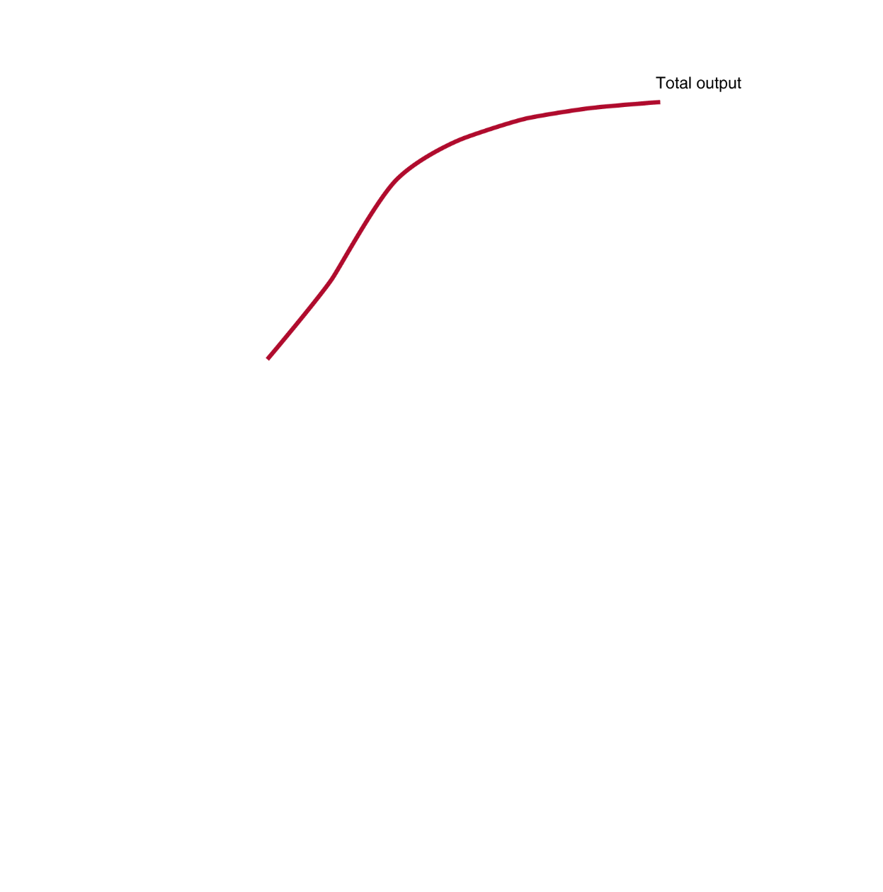
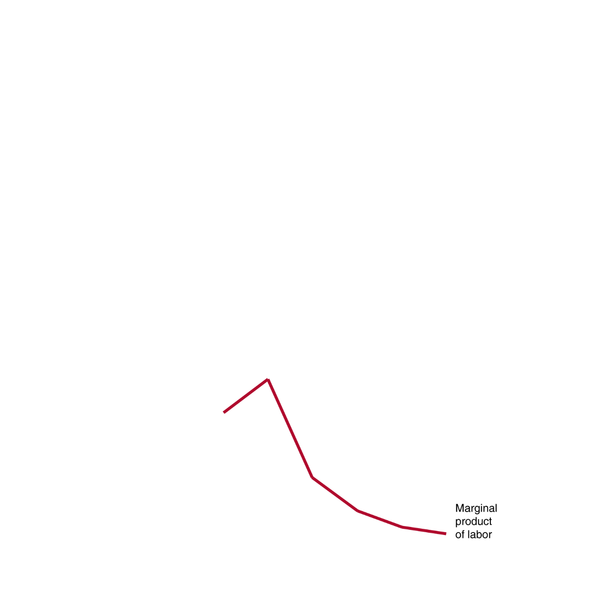
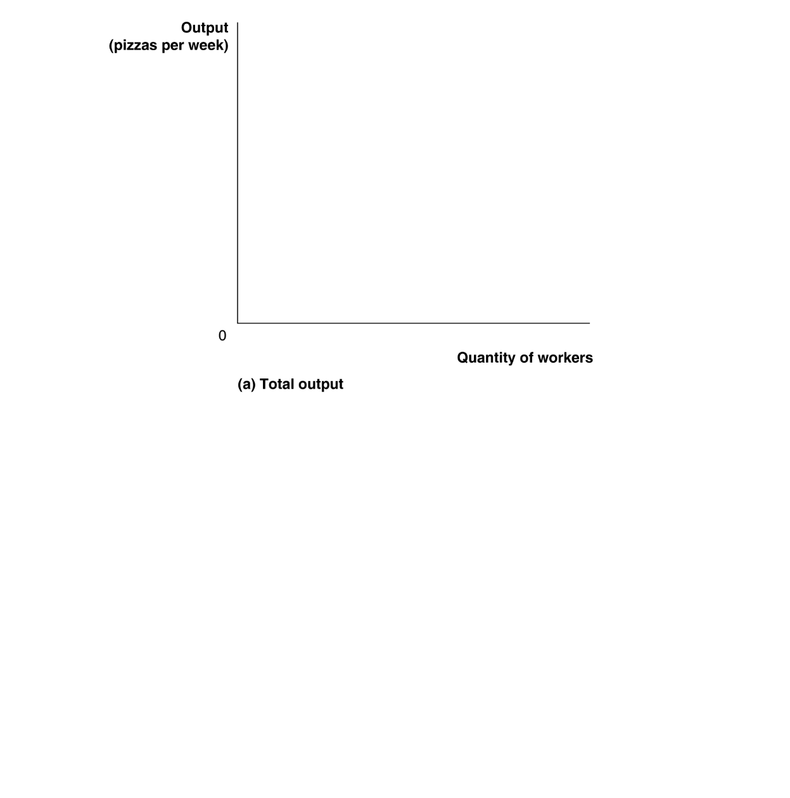
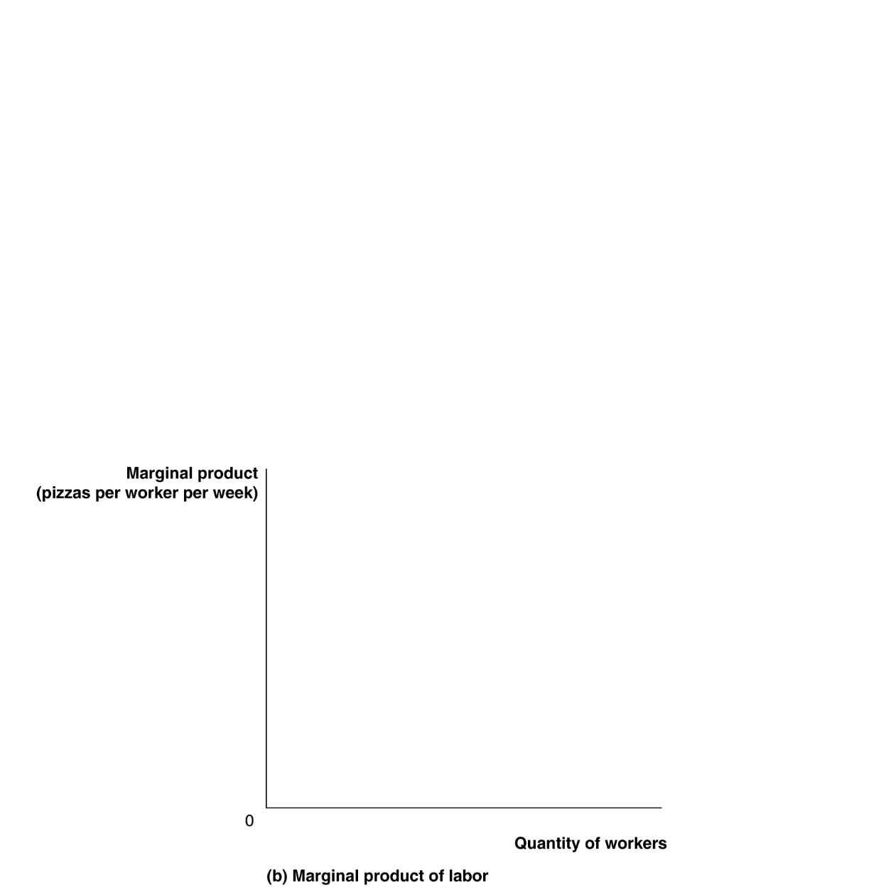

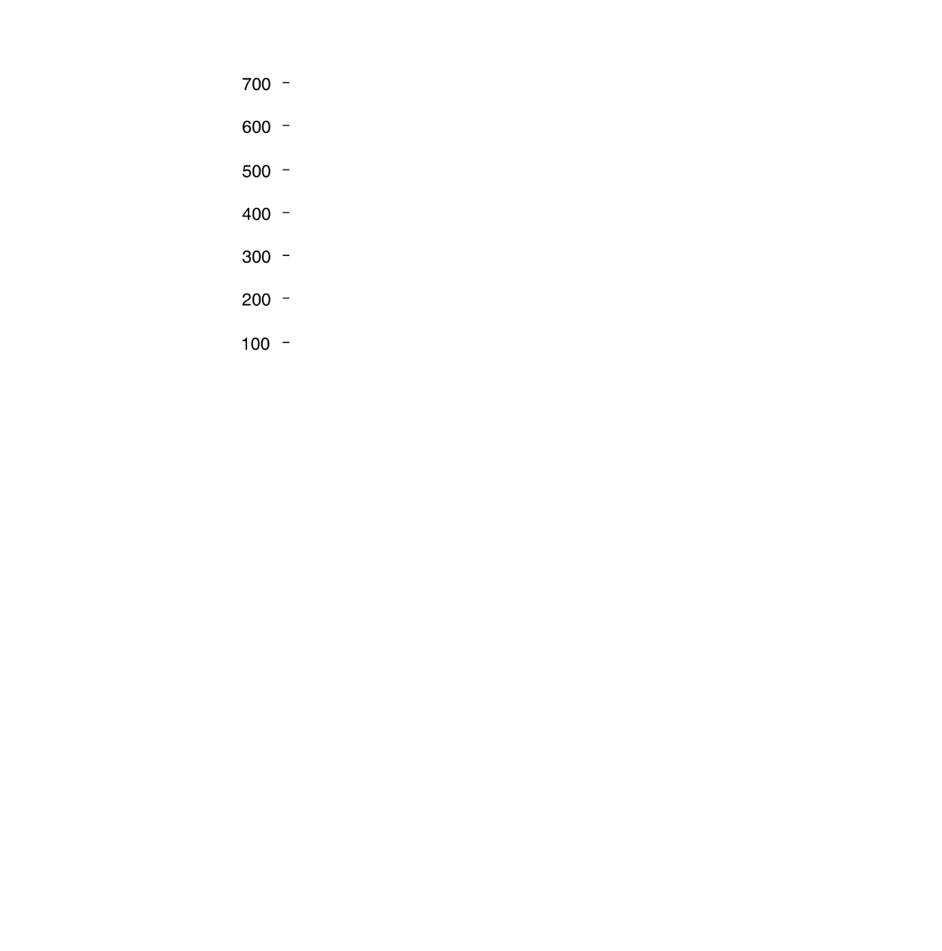



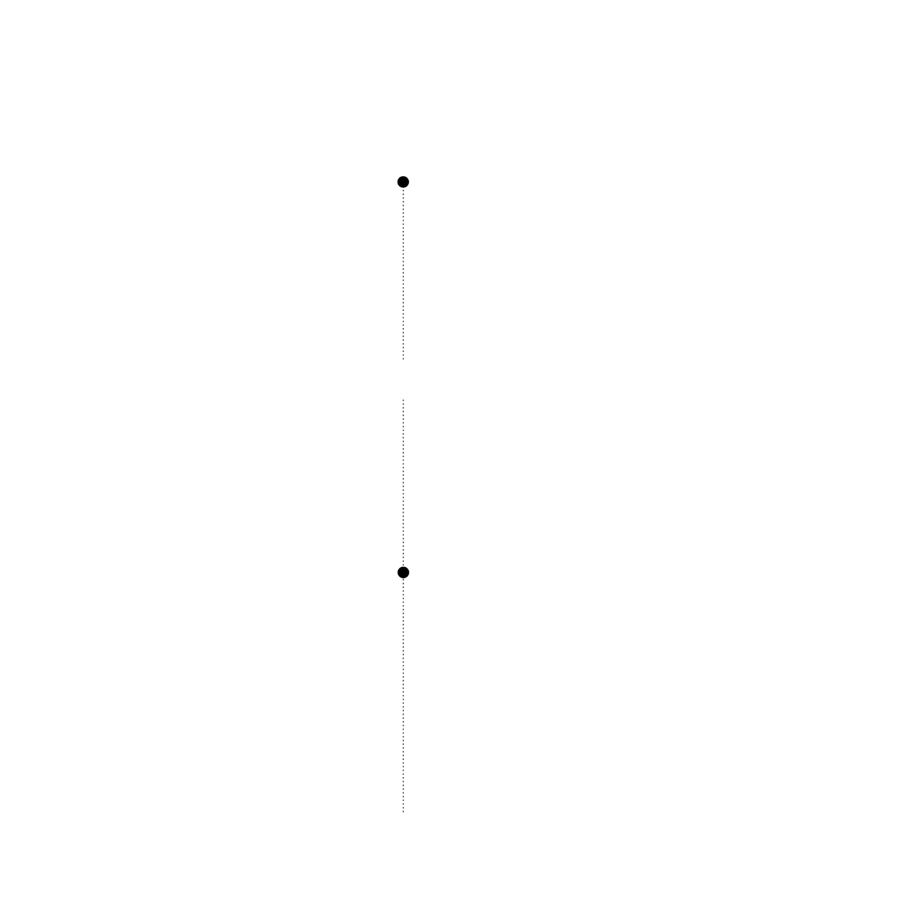
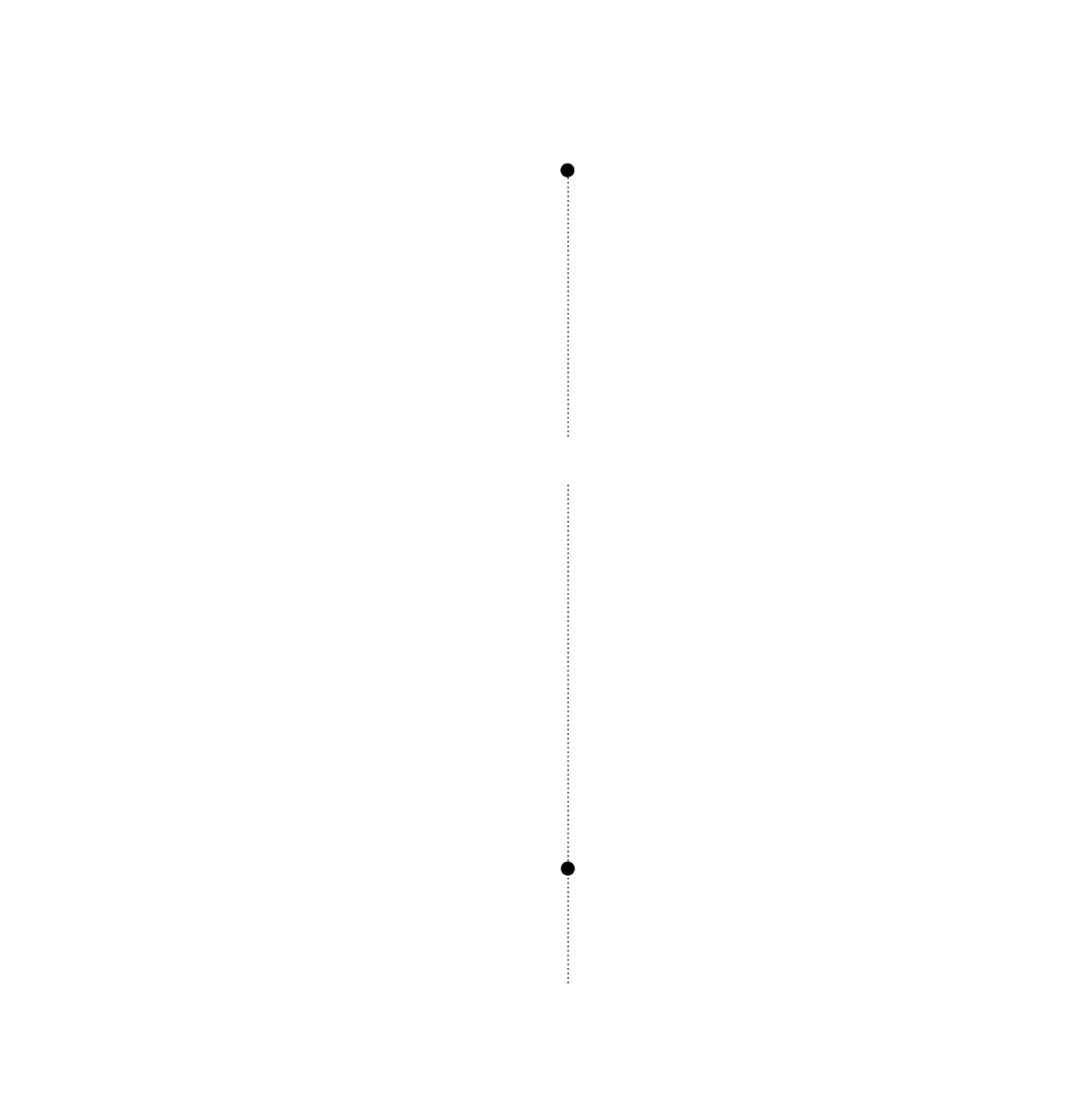
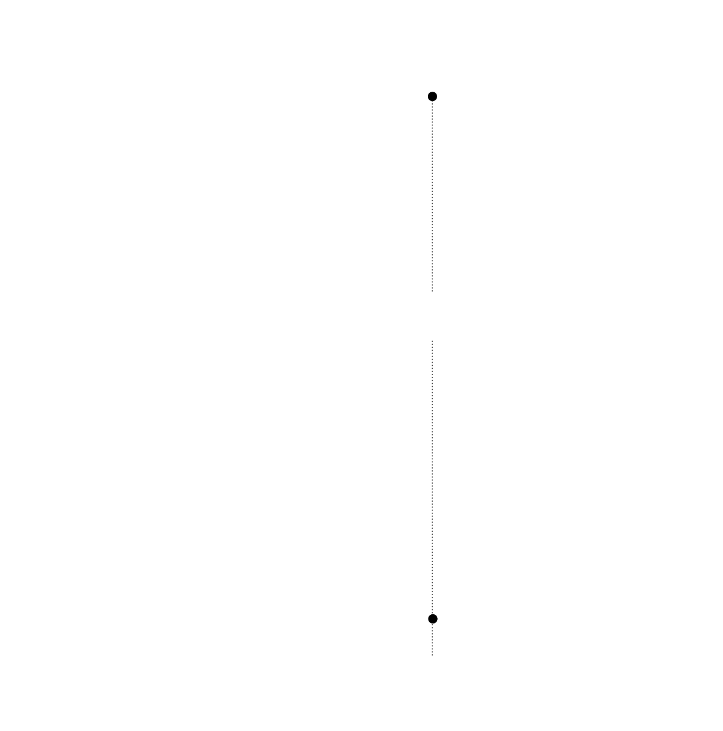
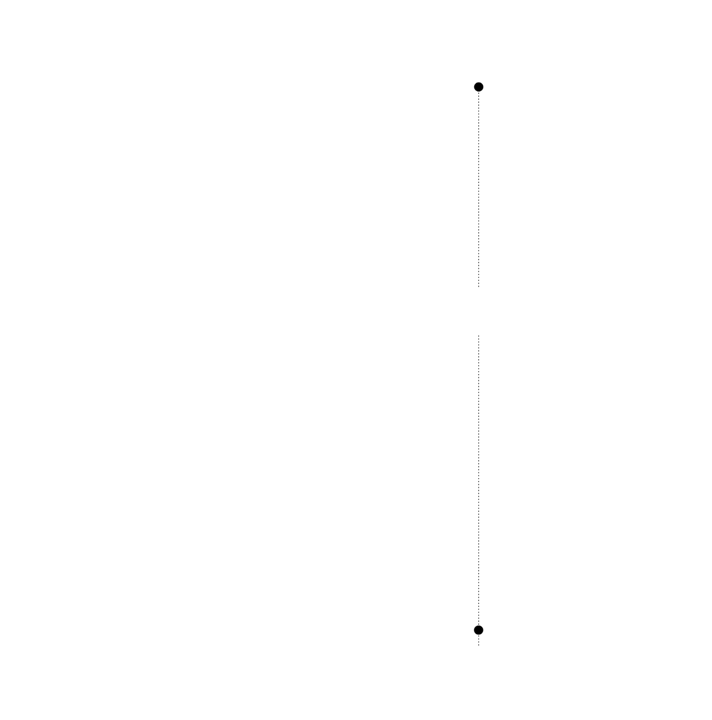
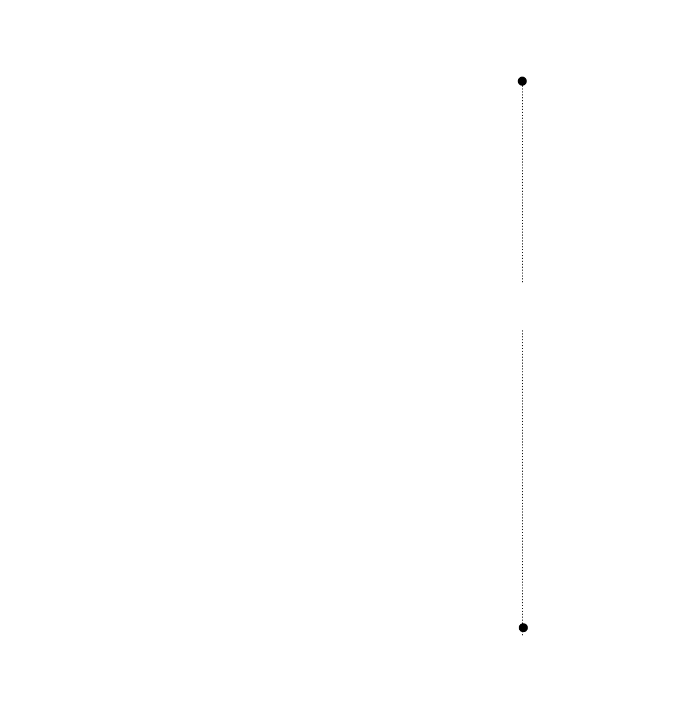
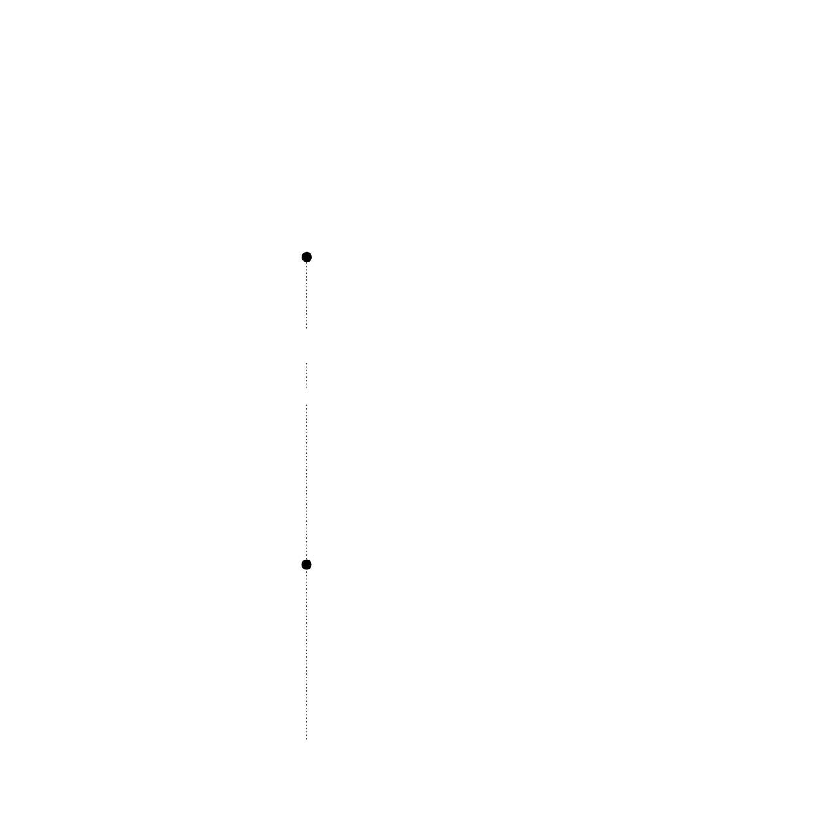
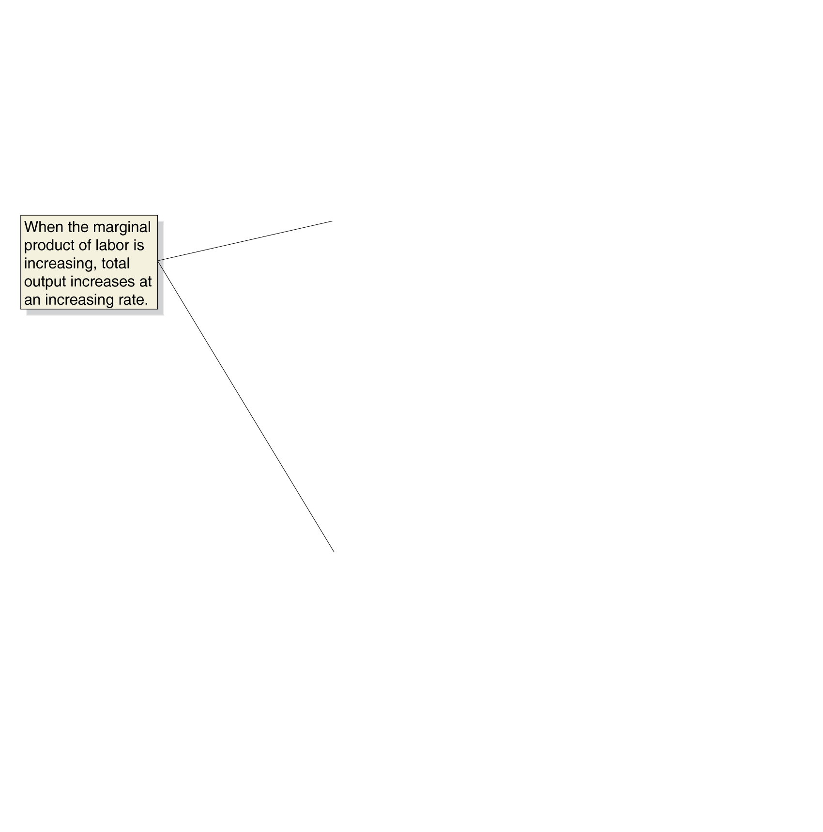
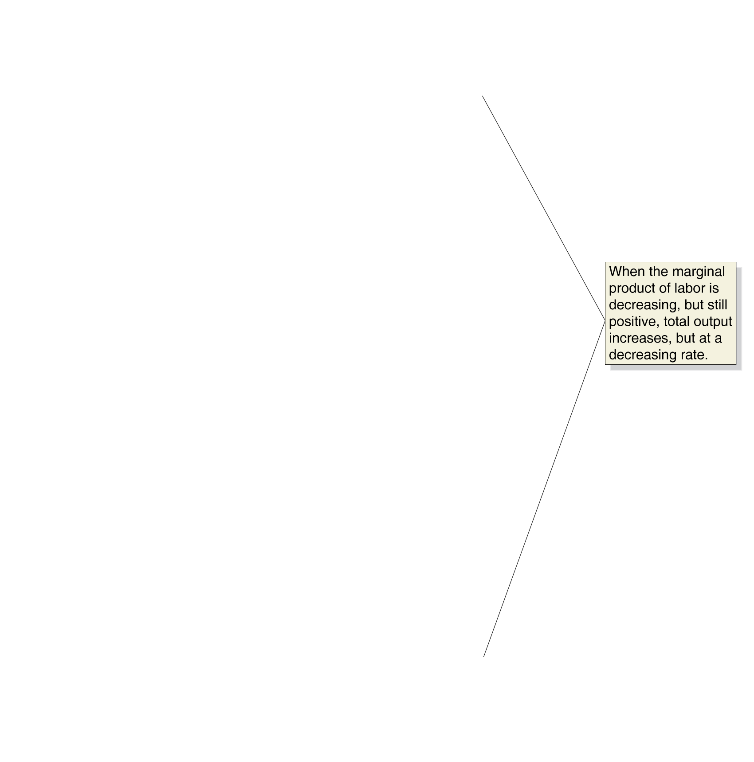
Graphing Production
Total Output and the Marginal Product of Labor
Why does MP rise initially?
Why does MP fall eventually?

Slide 12
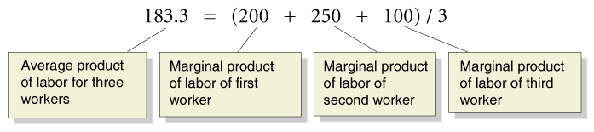
The Relationship between Marginal and Average Product
Average product of labor The total output produced by a firm divided by the quantity of workers.
AP of 1 worker:
AP of 2 workers:
AP of 3 workers:

Slide 13


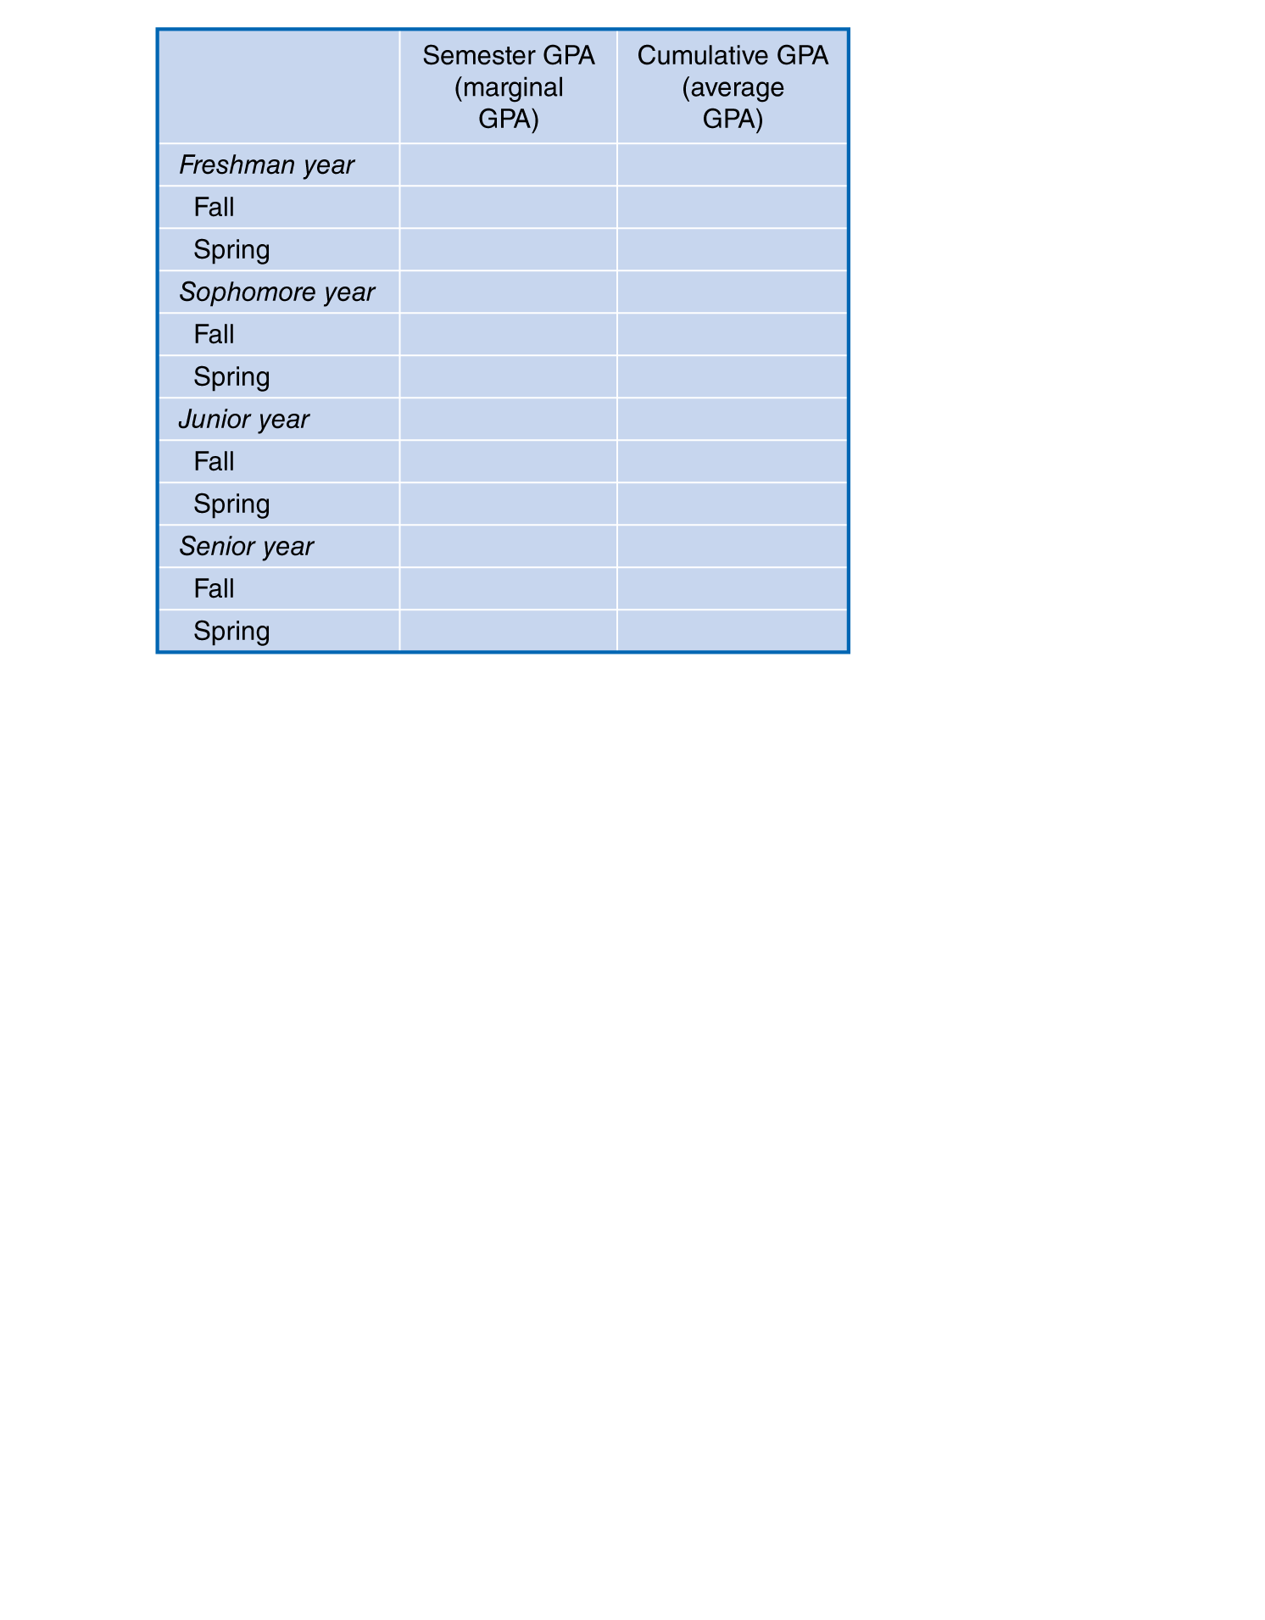
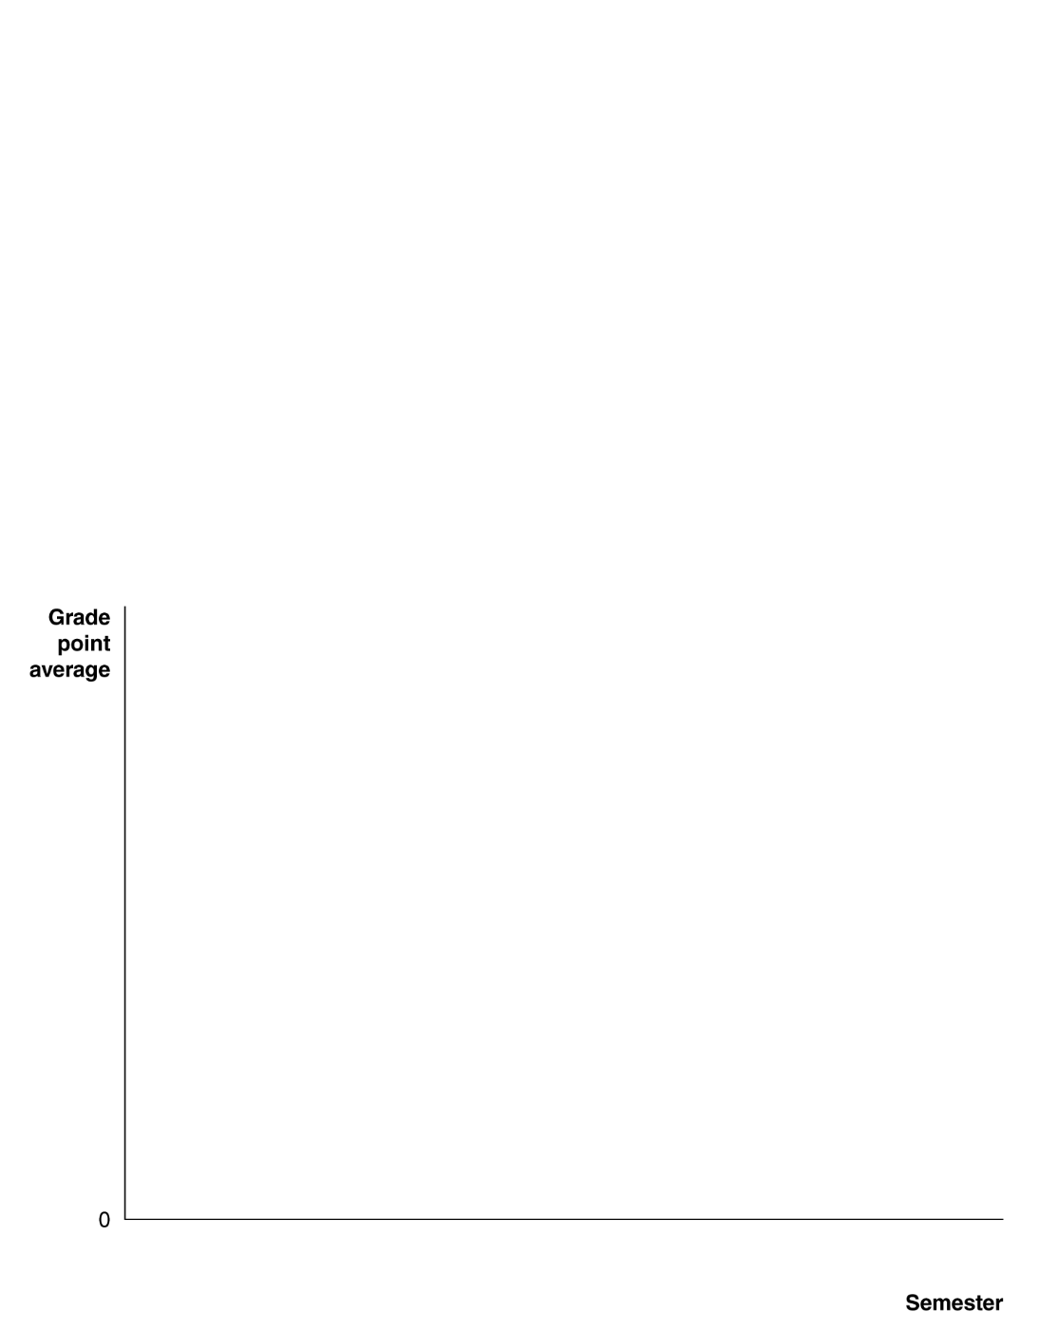
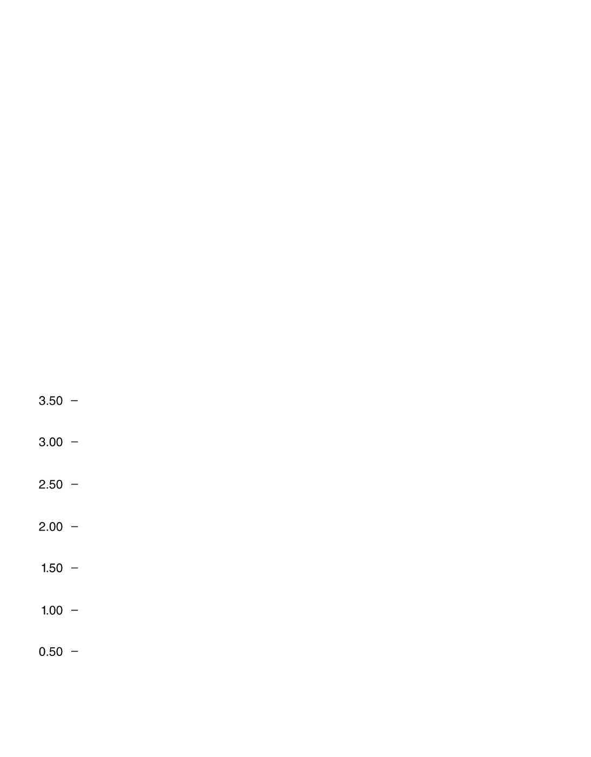

















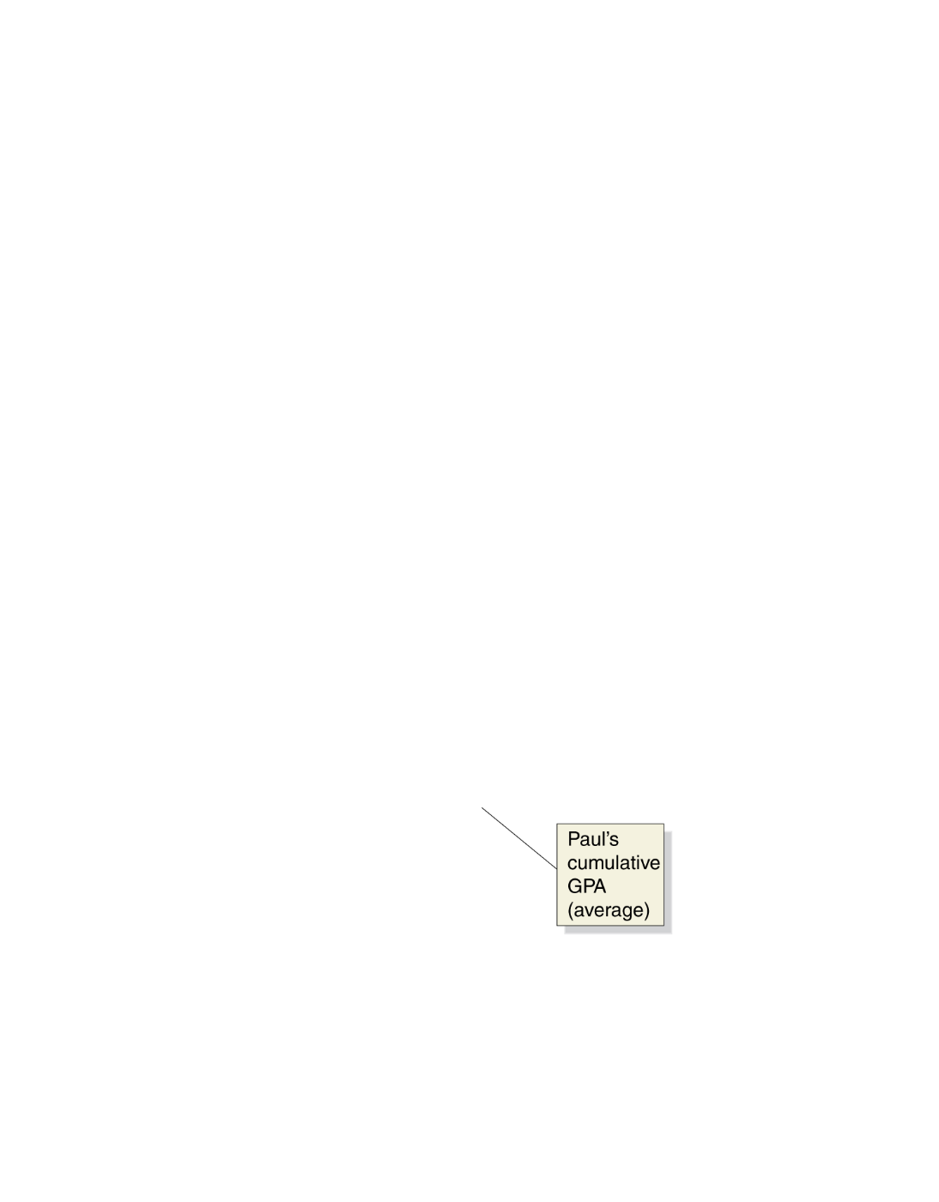
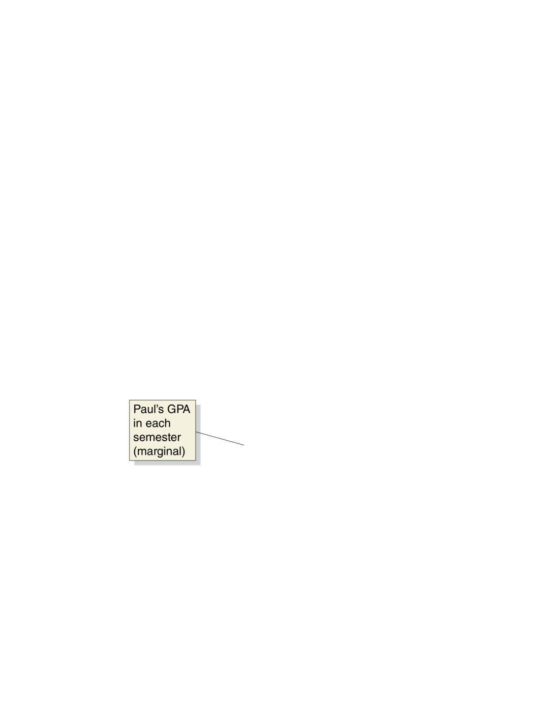
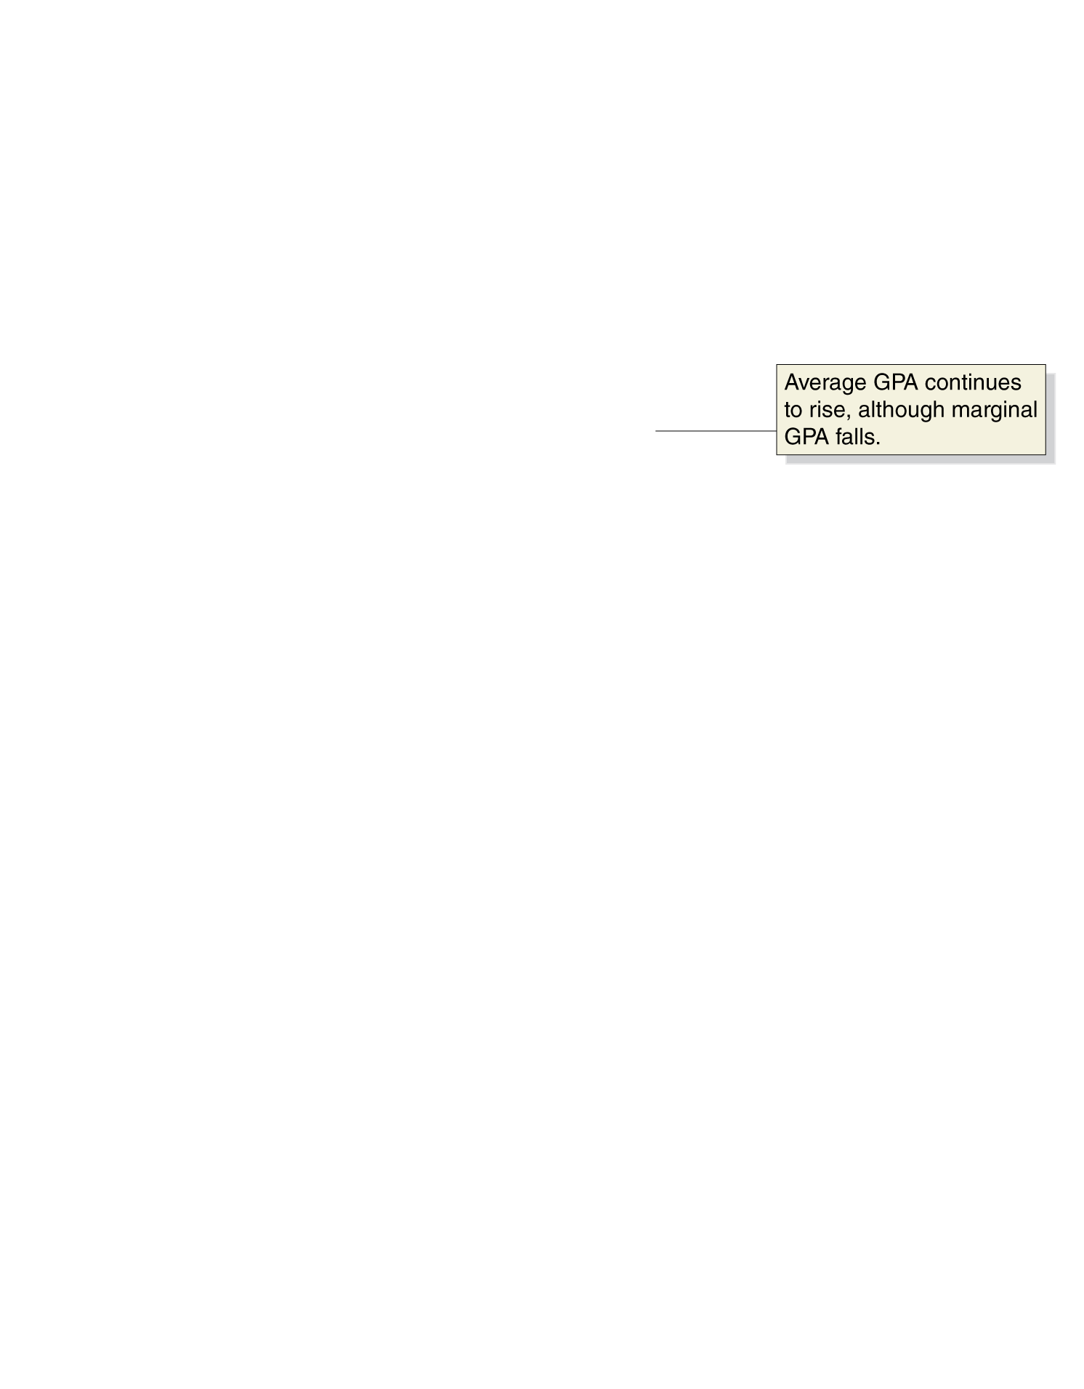
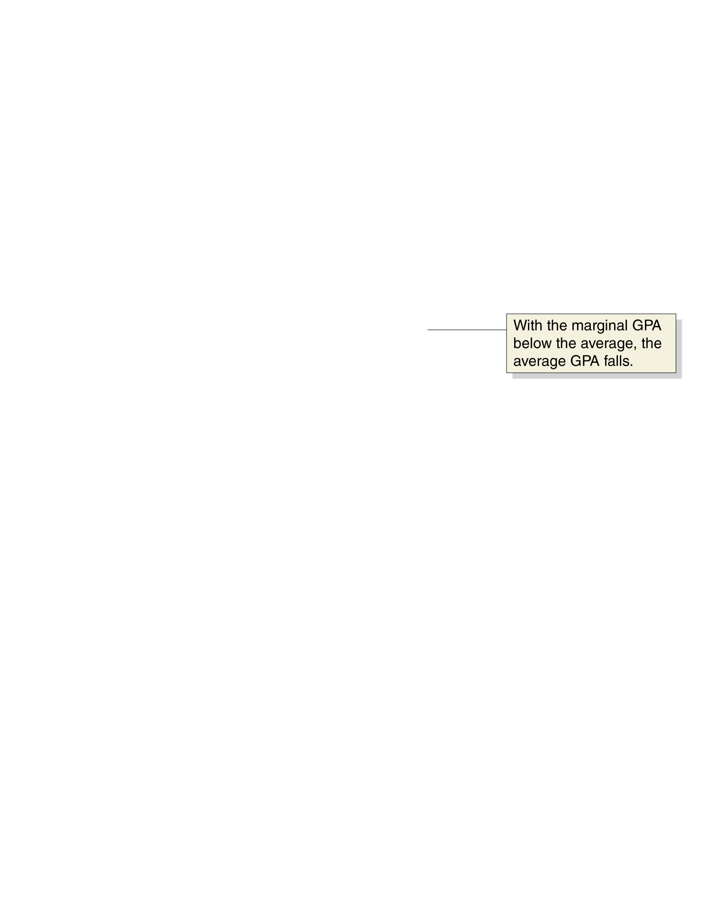
An Example of Marginal and Average Values: College Grades
Marginal and Average GPAs

Slide 14

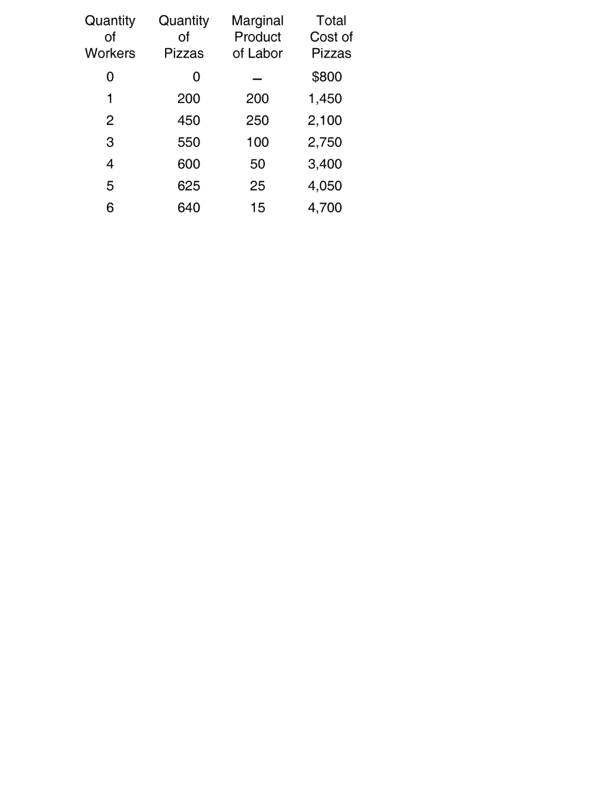
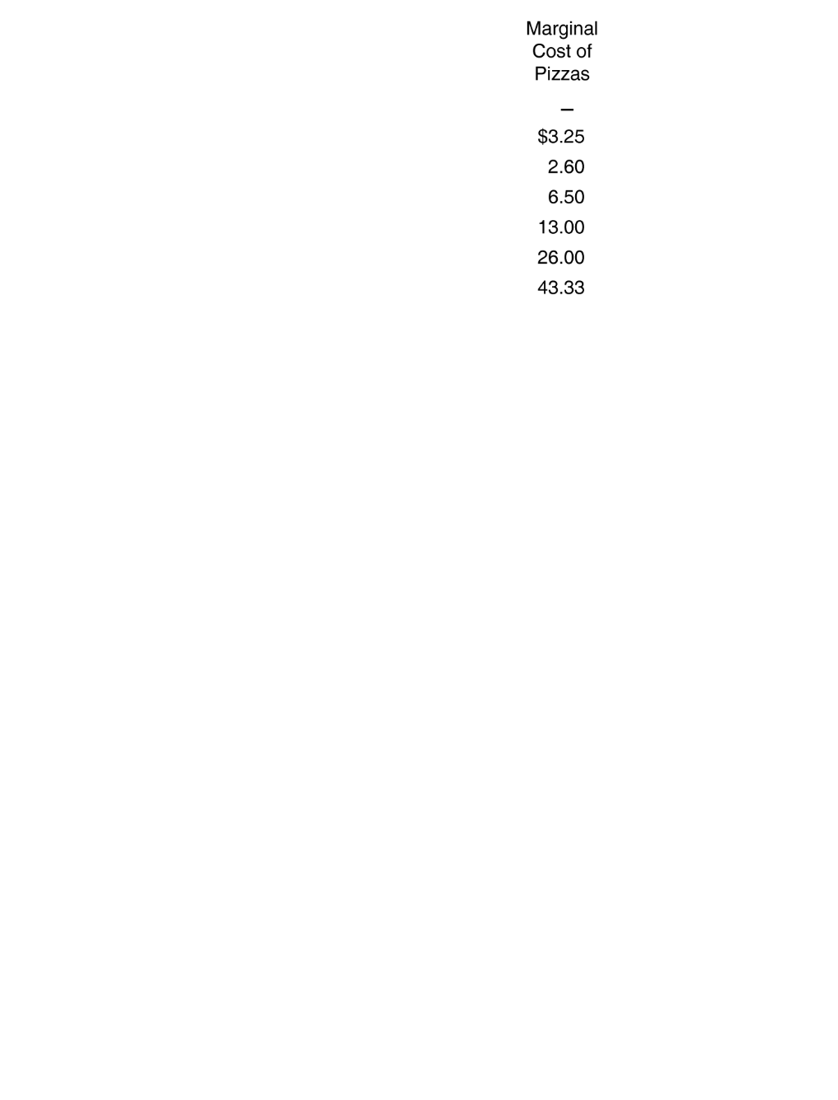
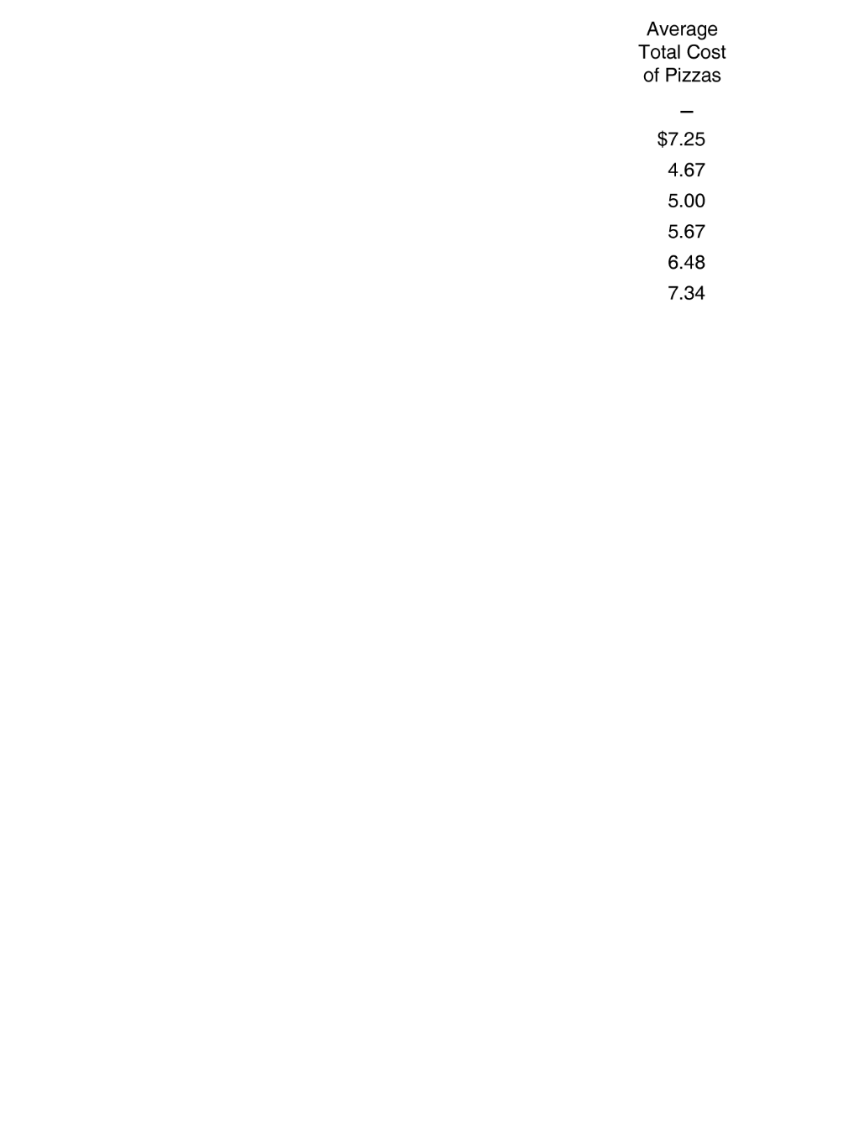
The Relationship between Short-Run Production and Short-Run Cost
Marginal cost The change in a firm’s total cost from producing one more unit of a good or service.

Slide 15
Relationship between Marginal Product of Labor
and Marginal Cost of Producing Output

Slide 16

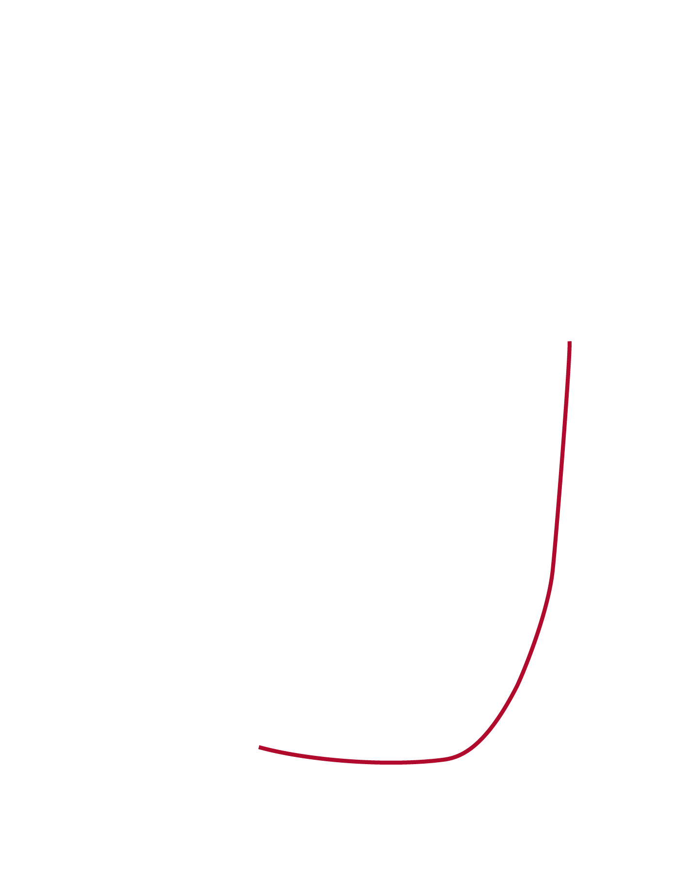
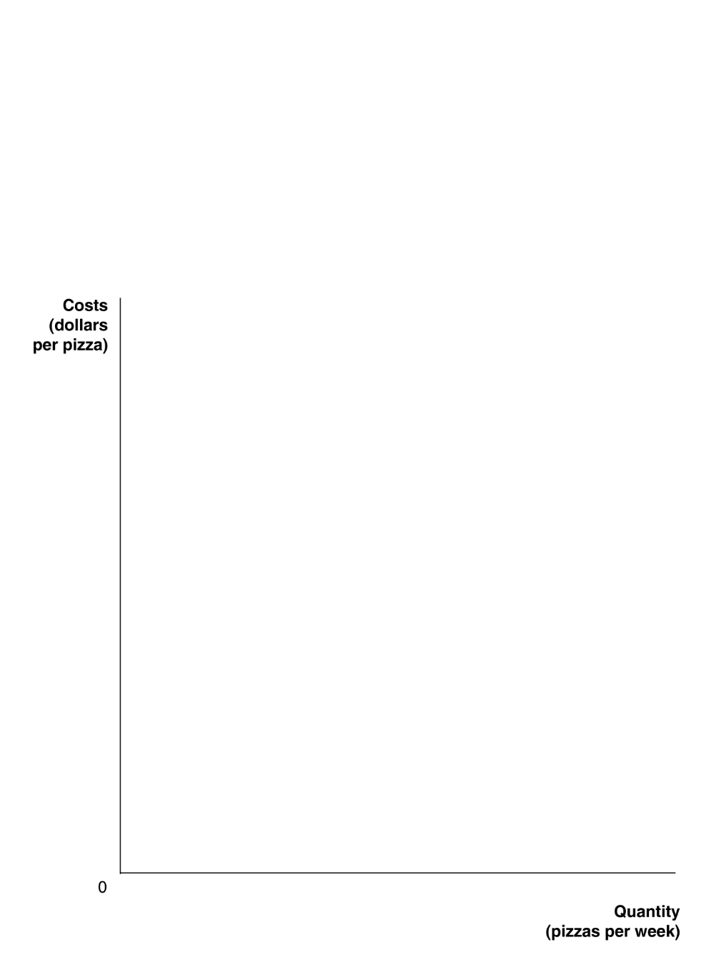
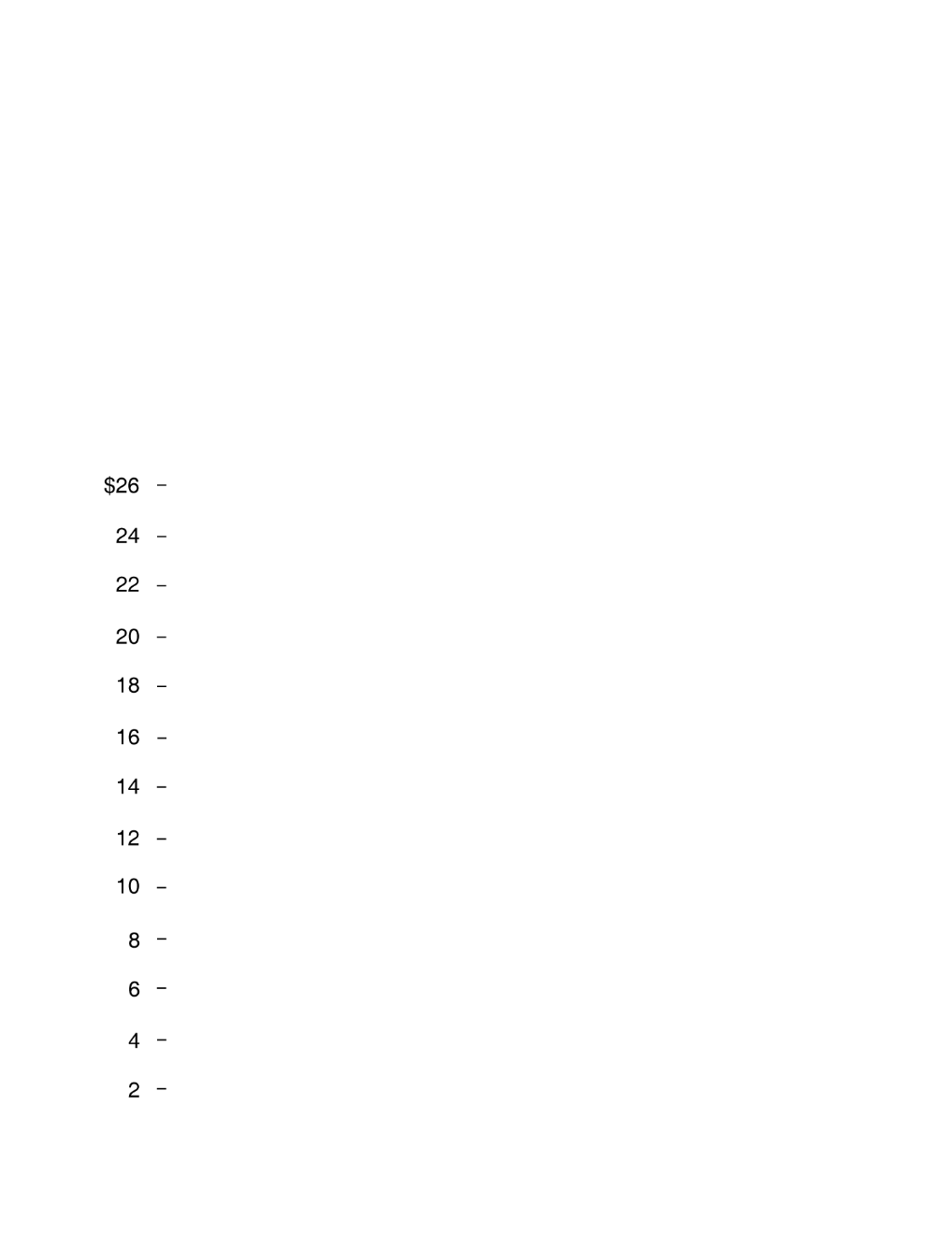
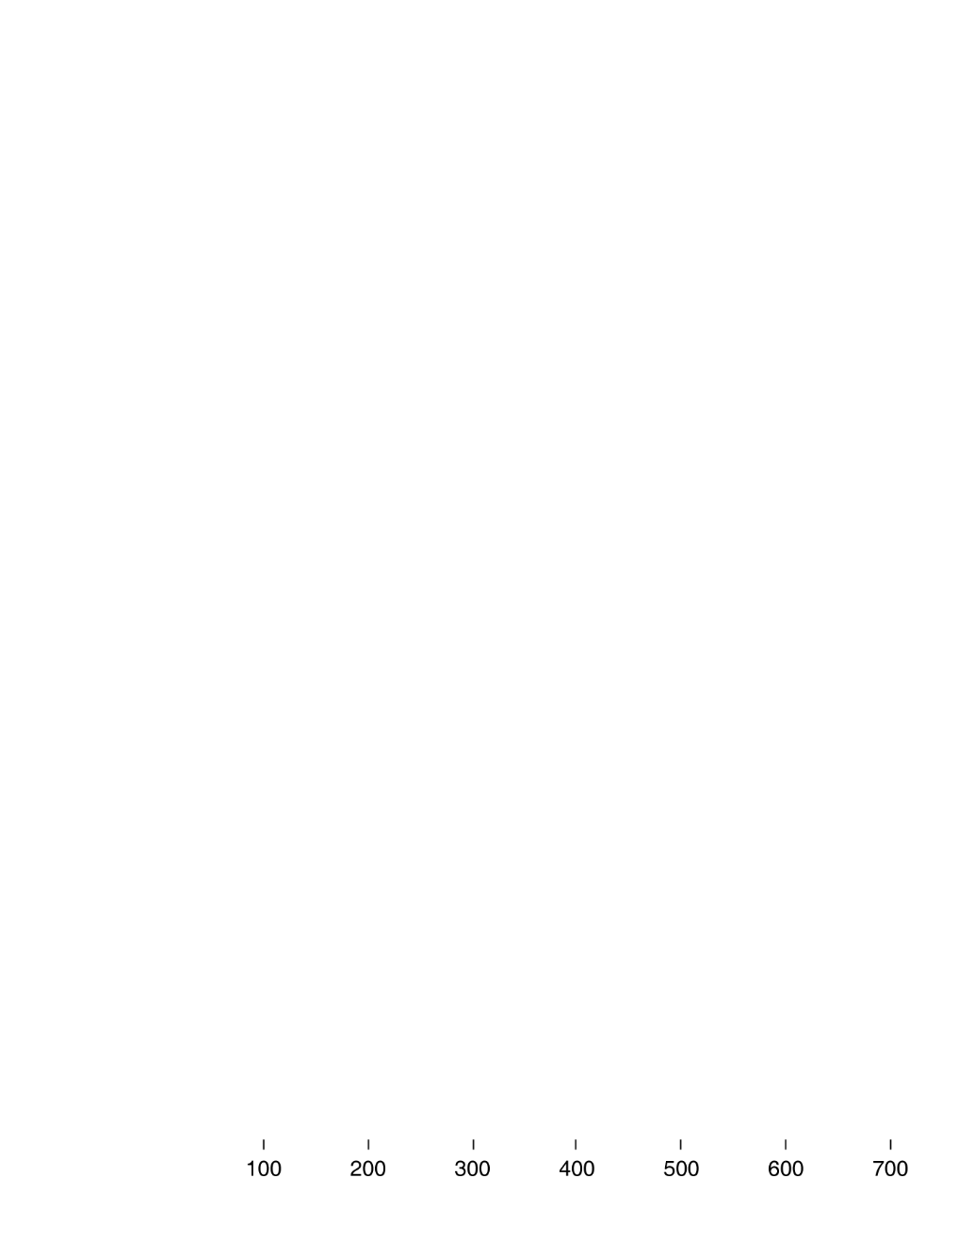
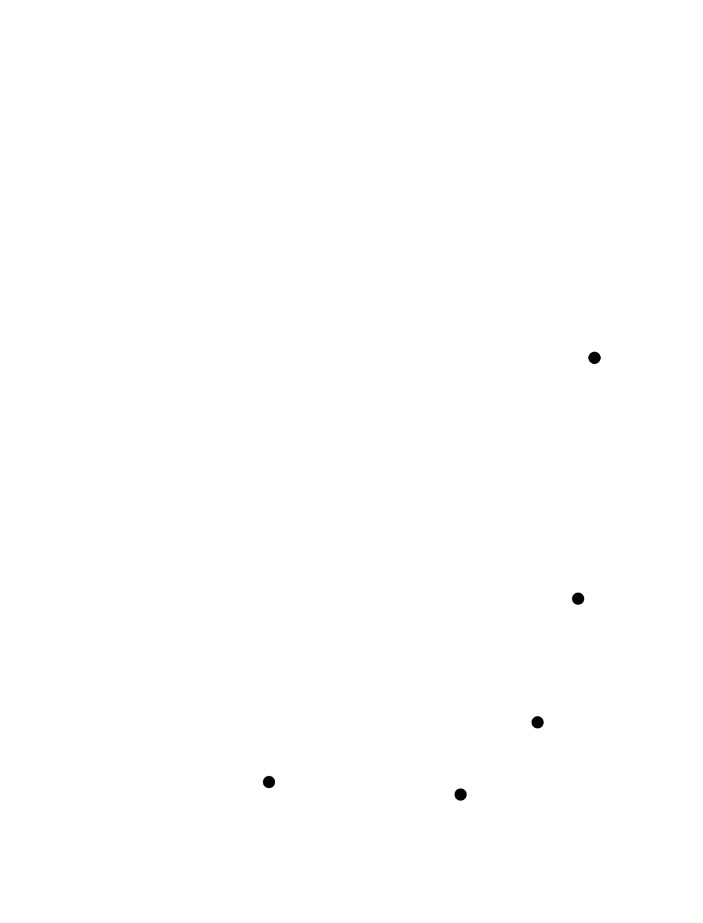
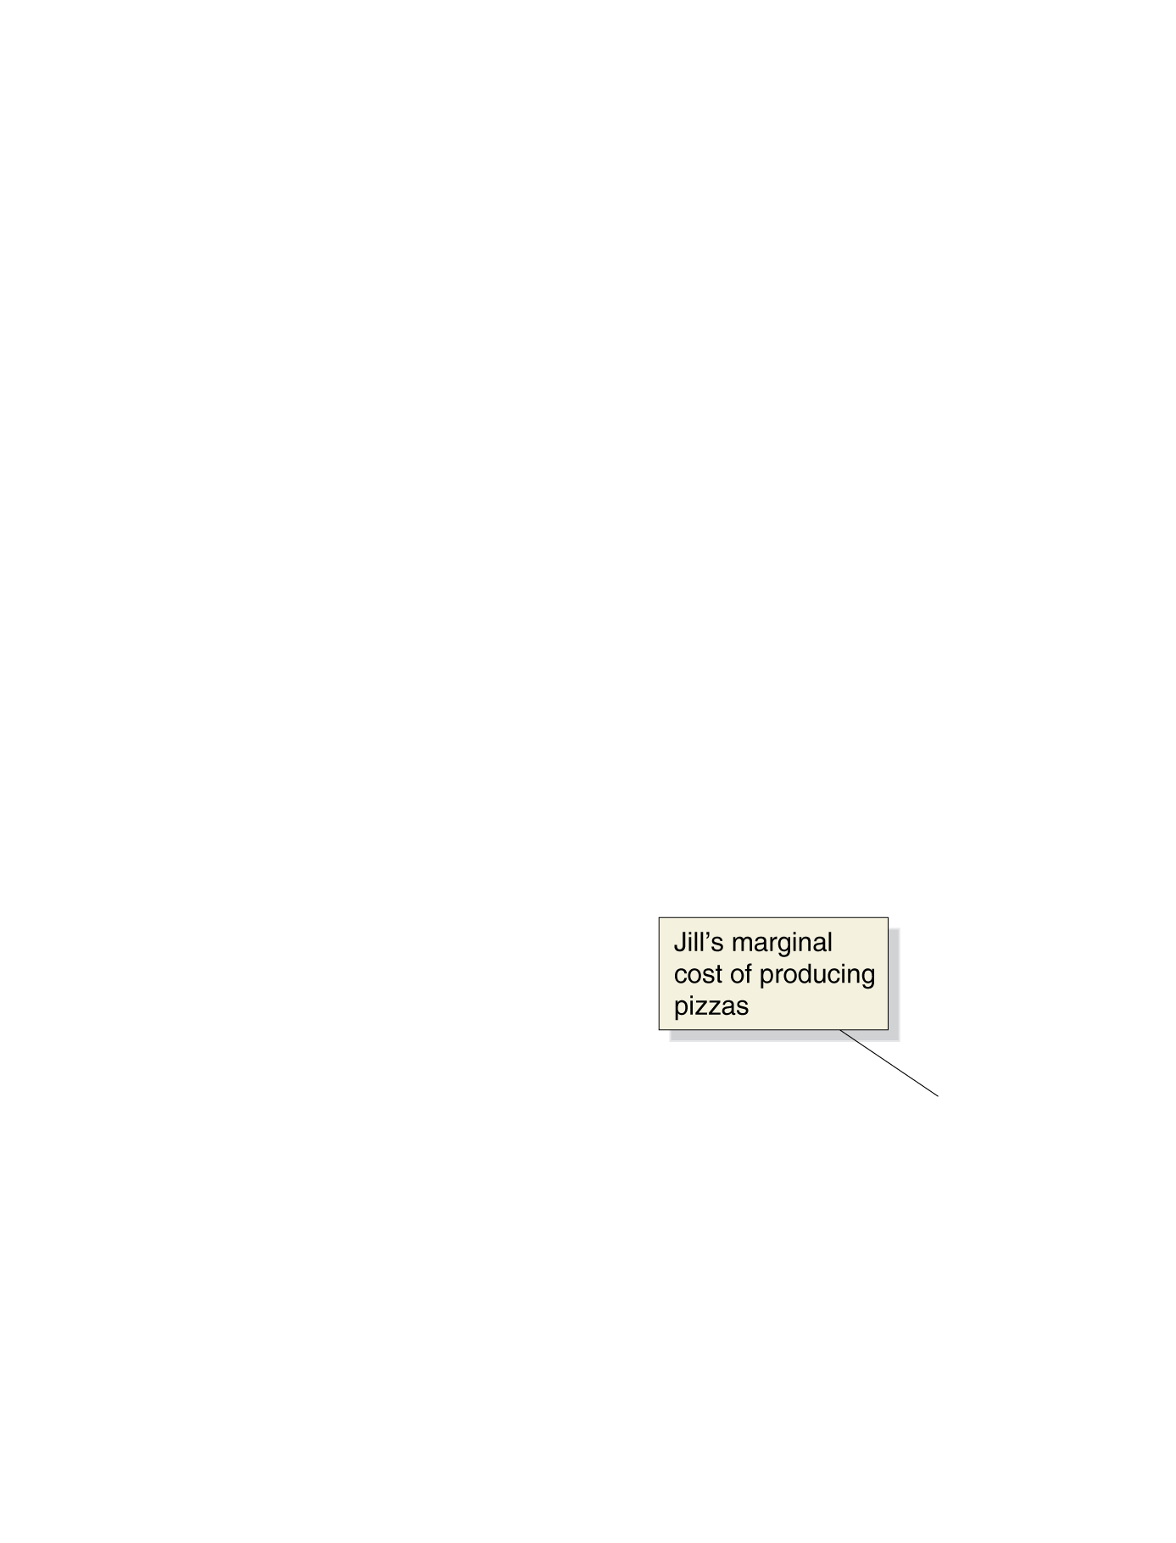

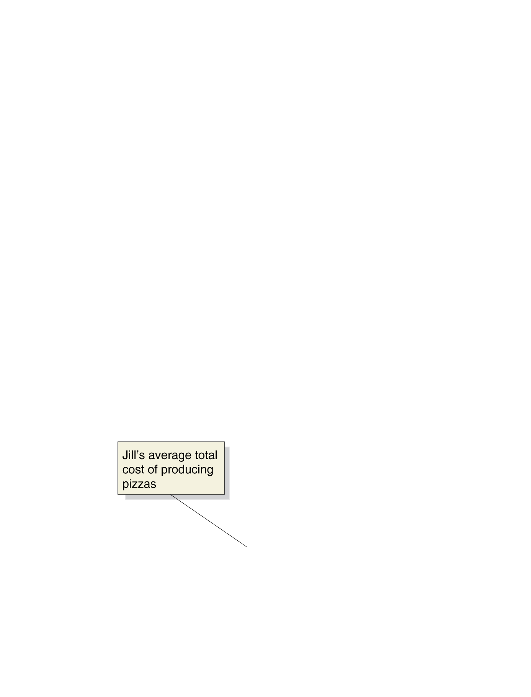
Why Are the Marginal and Average Cost Curves U Shaped?
Jill Johnson’s Marginal Cost and Average Total Cost of Producing Pizzas

Slide 17
Relationship between Marginal Cost and Average Cost
Suppose that you are producing 1000 mountain bikes and your total cost are $300,000. You know if you produce 1001 bikes your total cost will be $300,500. Is your MC increasing/decreasing? Is your ATC increasing/decreasing?

Slide 18
Other Cost Expressions
Average total cost Total cost divided by the quantity of output produced.
Average fixed cost Fixed cost divided by the quantity of output produced.
Average variable cost Variable cost divided by the quantity of output produced.

Slide 19
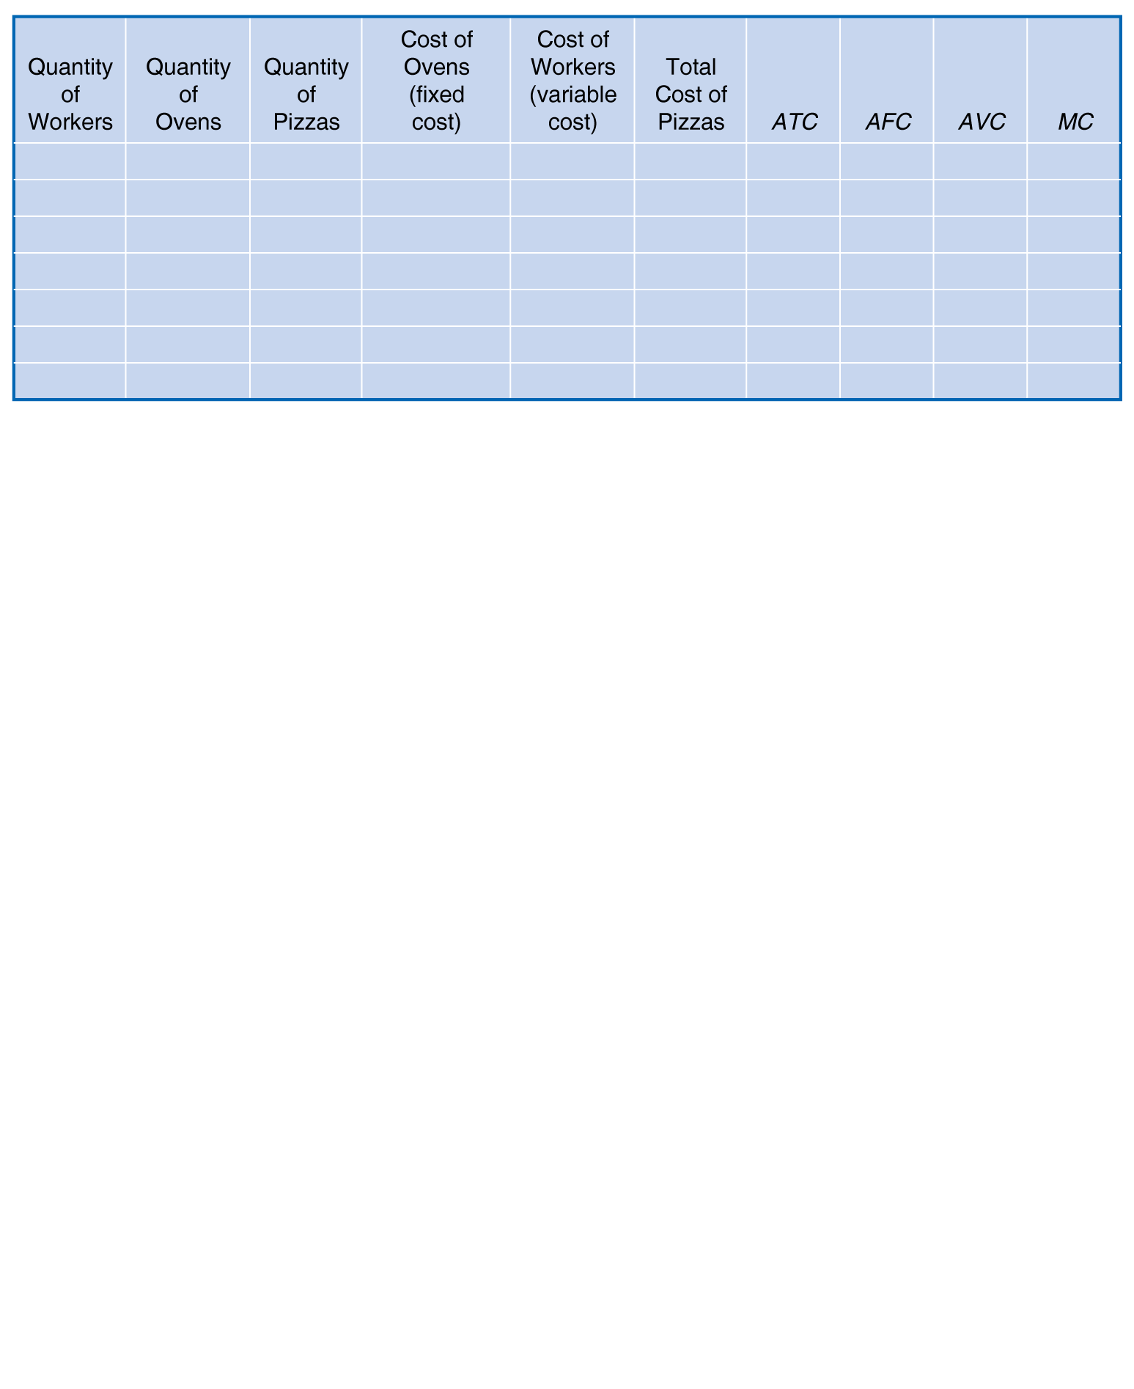
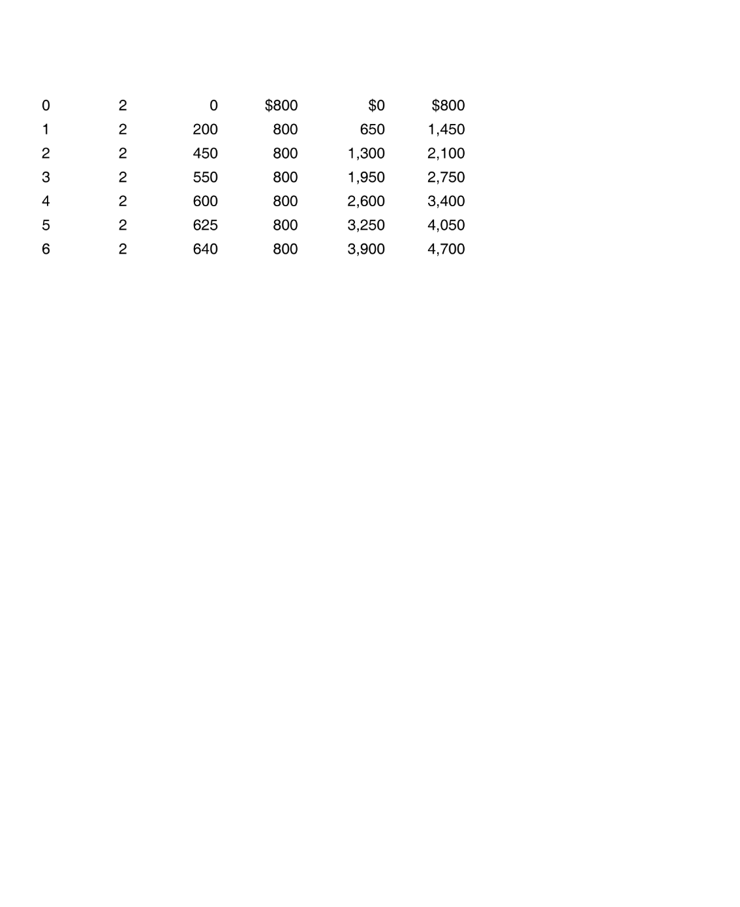
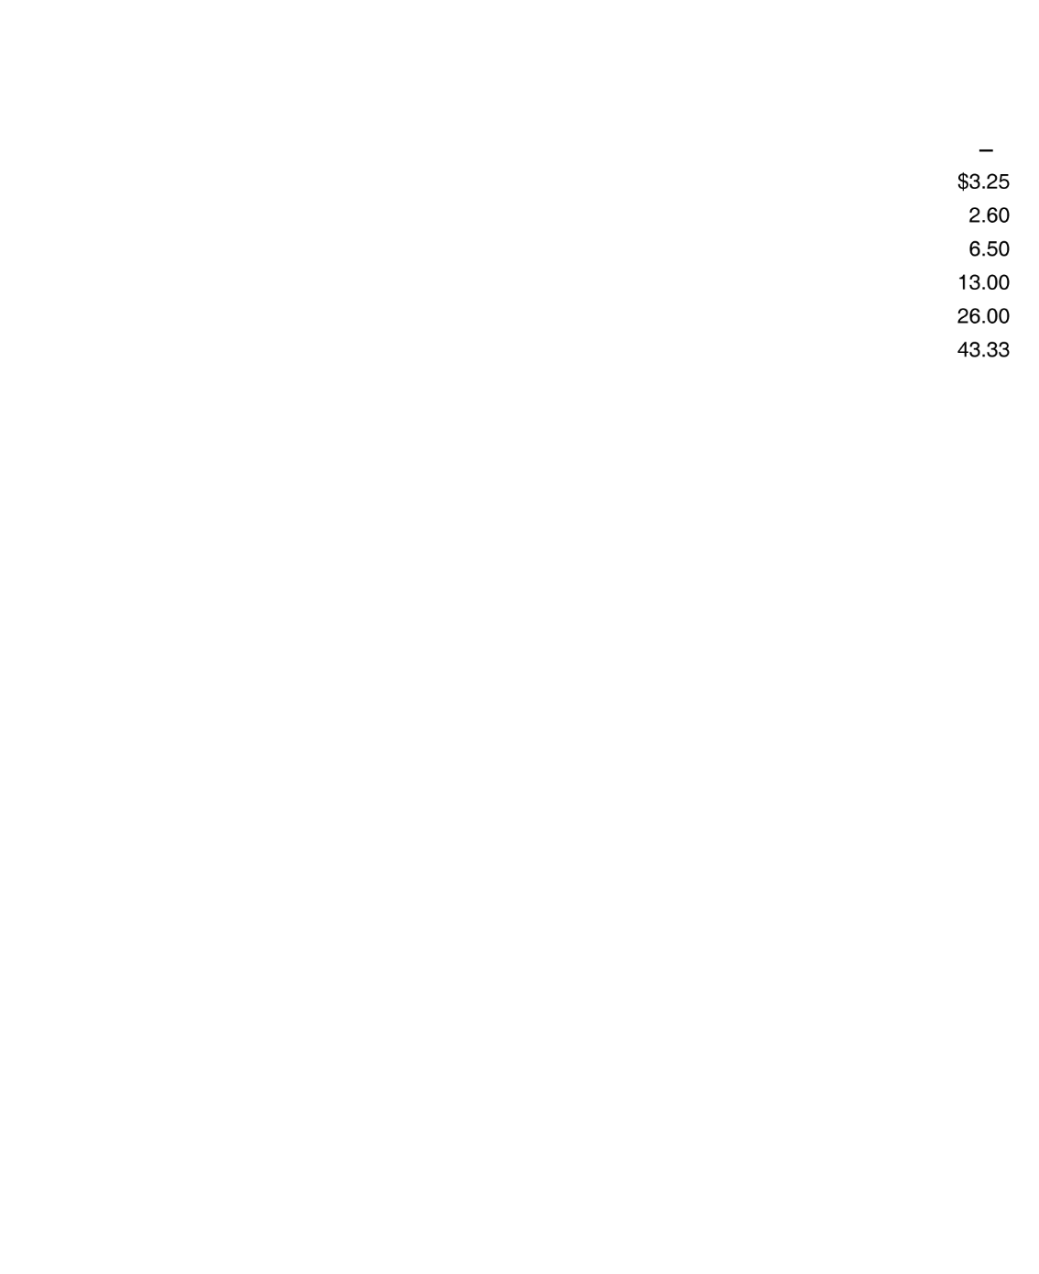
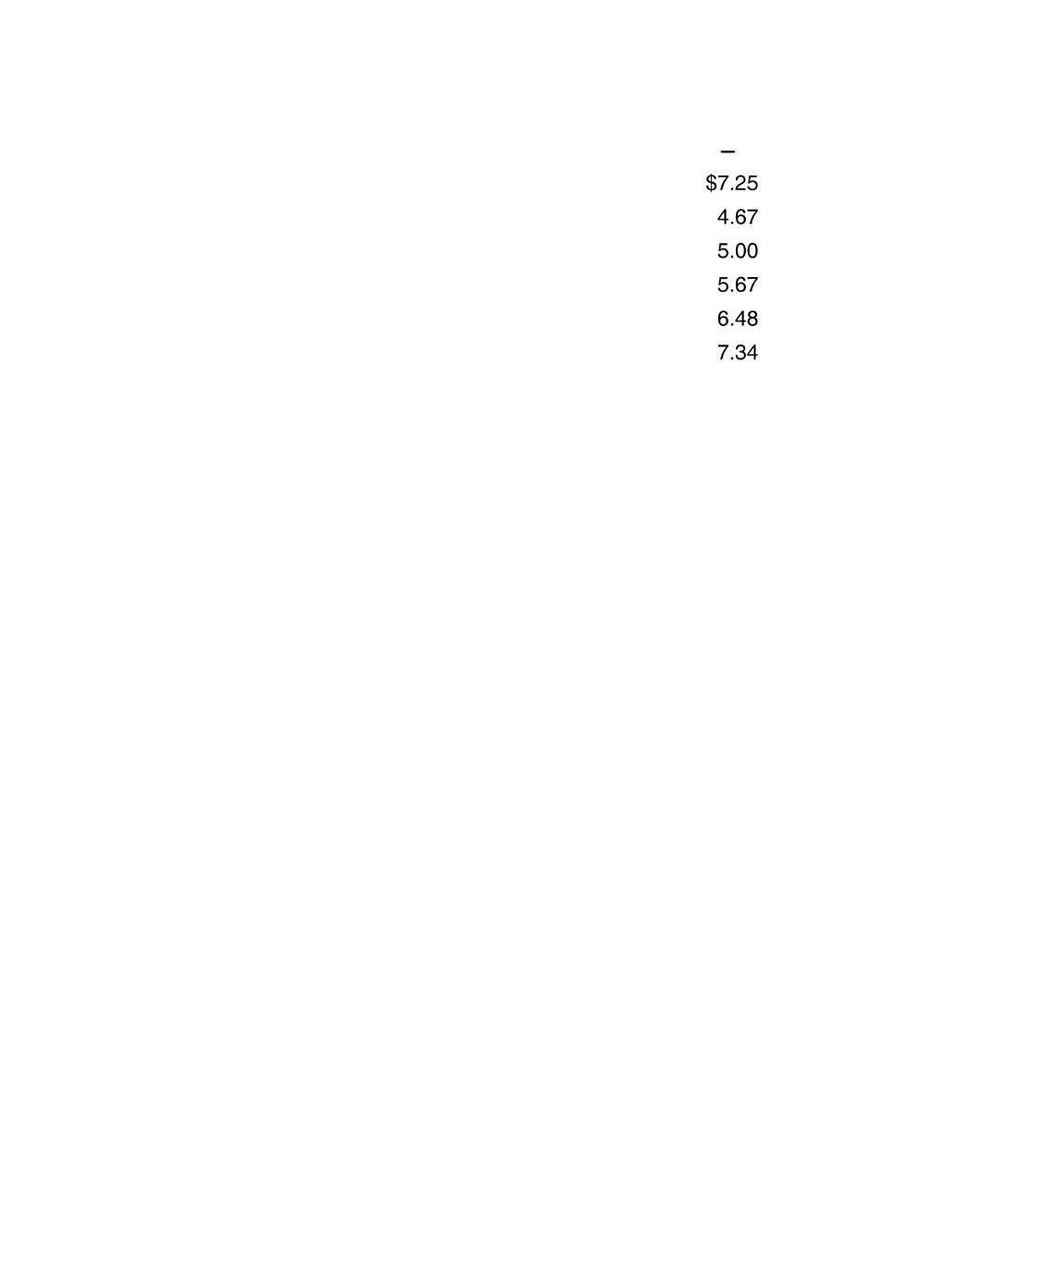
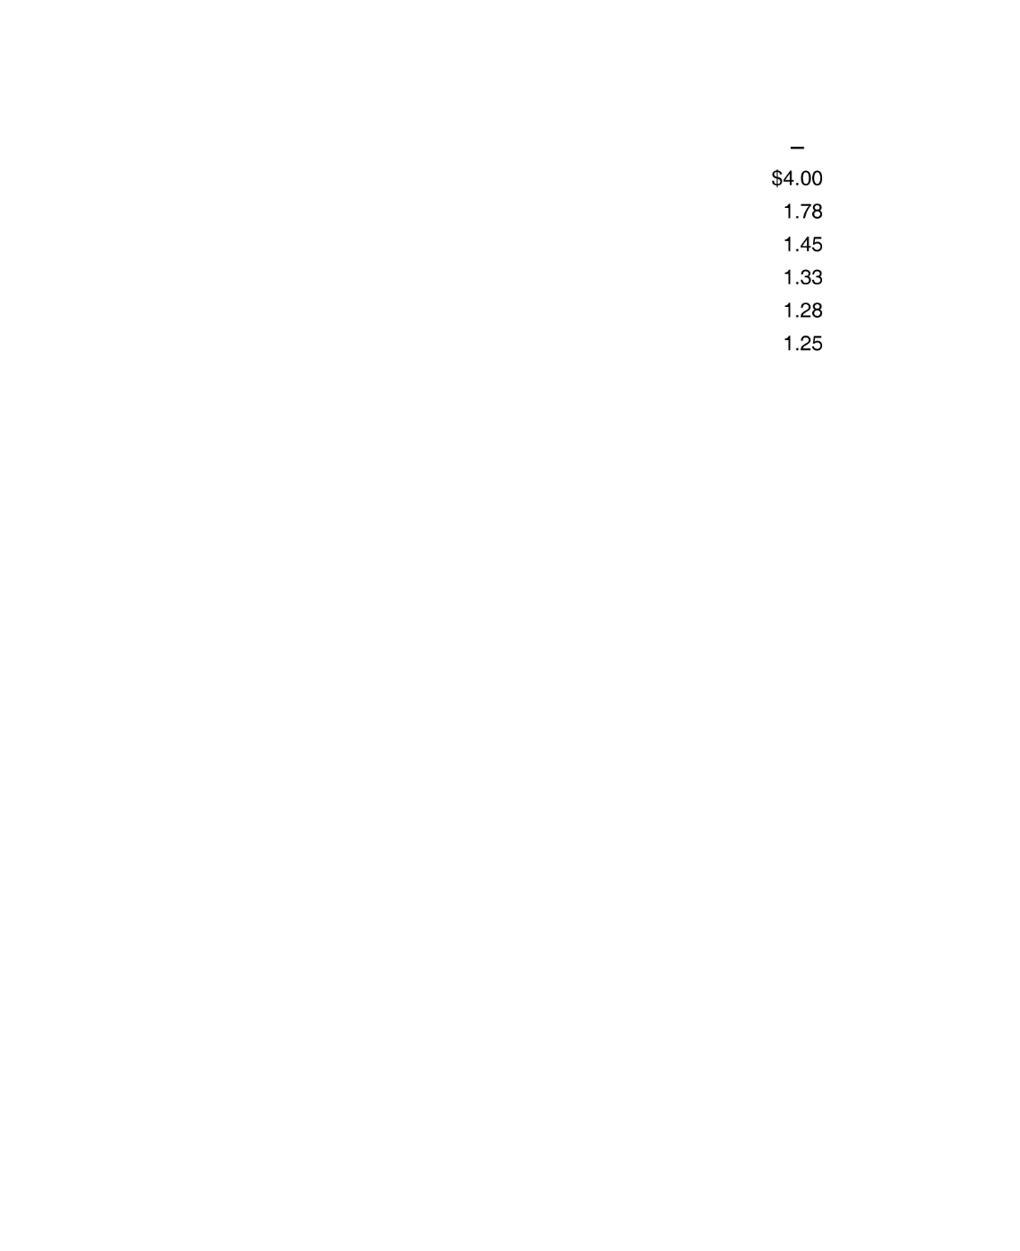
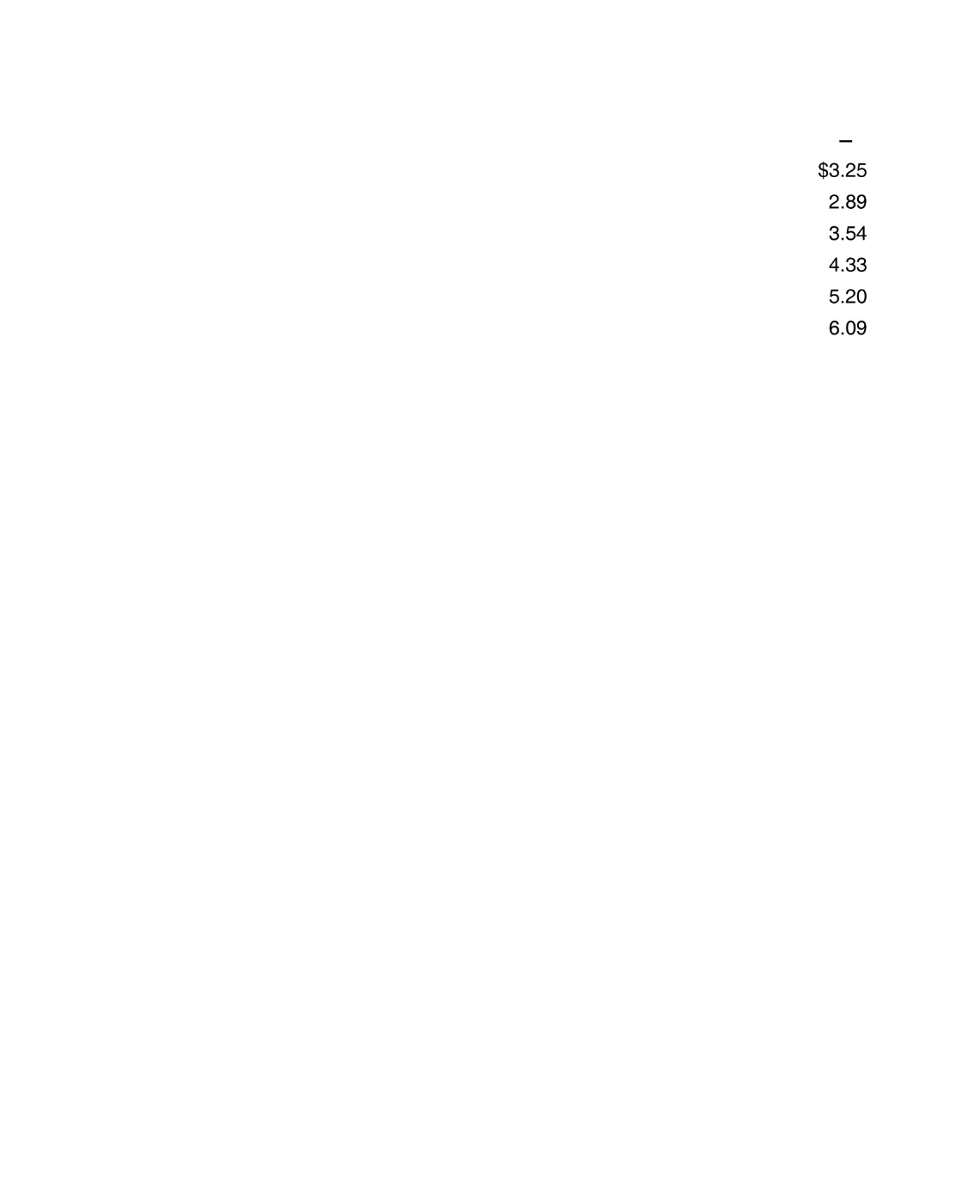
Costs at Jill Johnson’s Restaurant

Slide 20

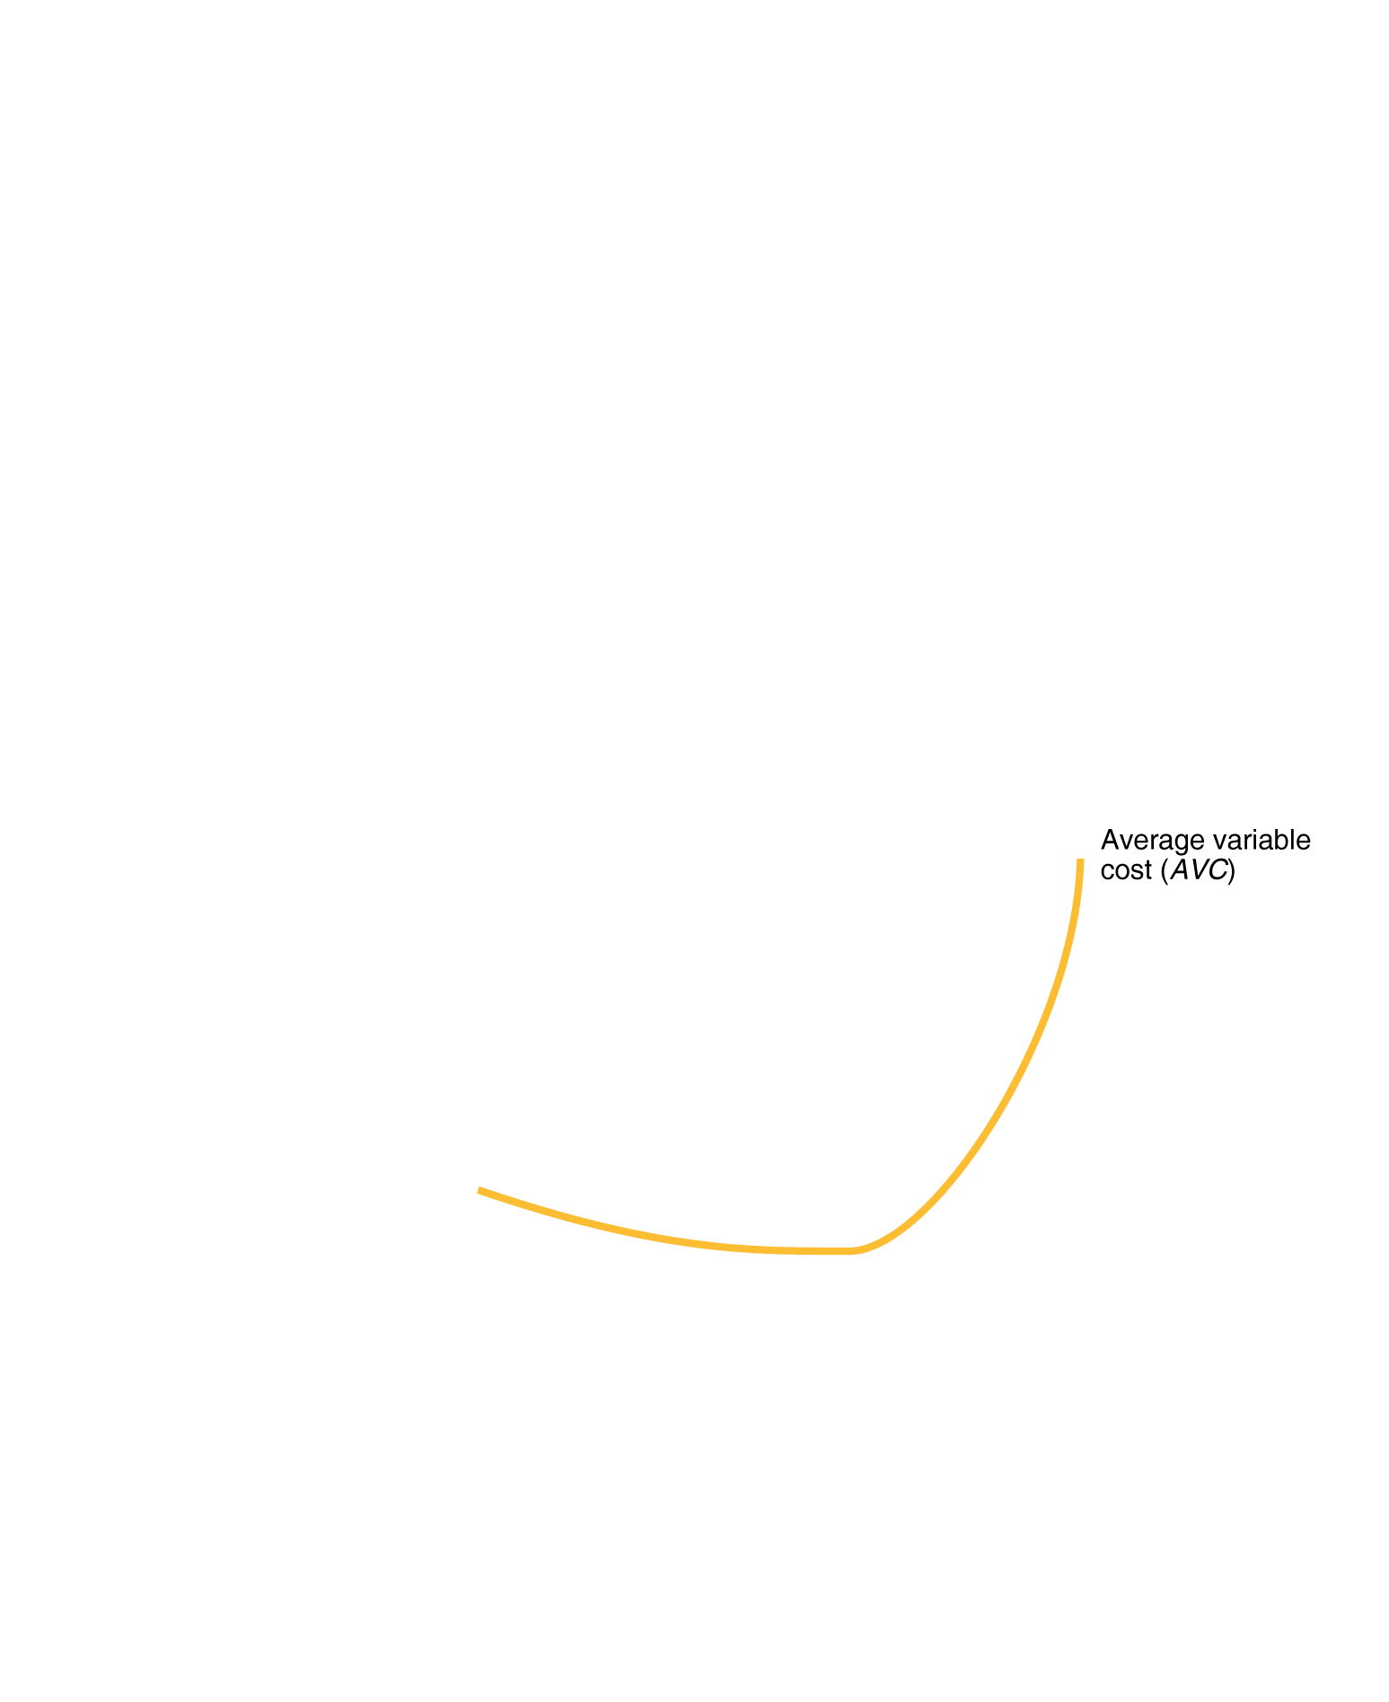
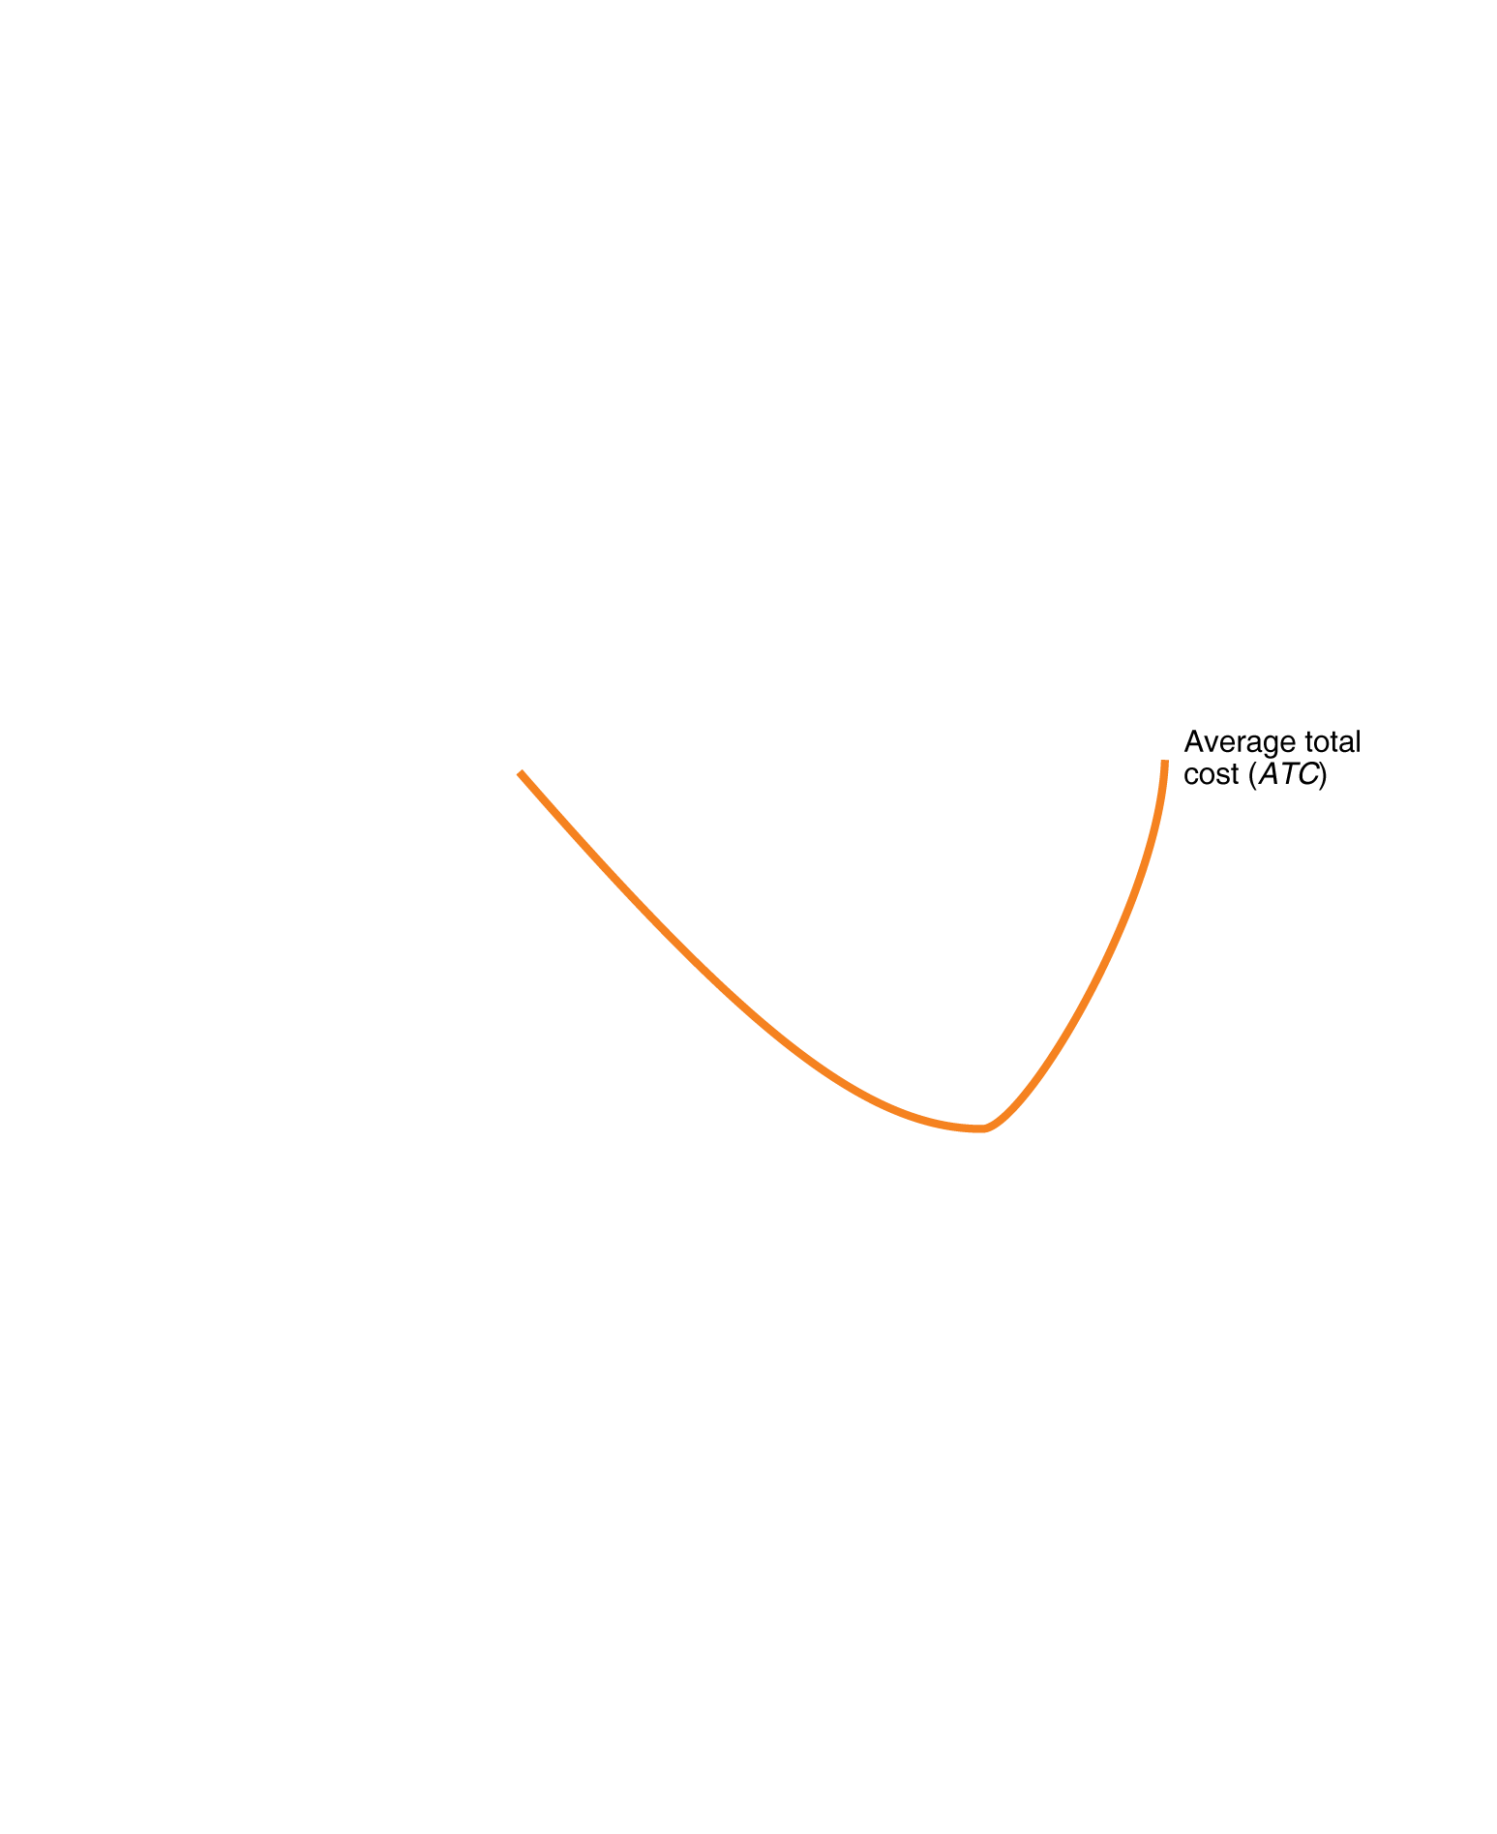
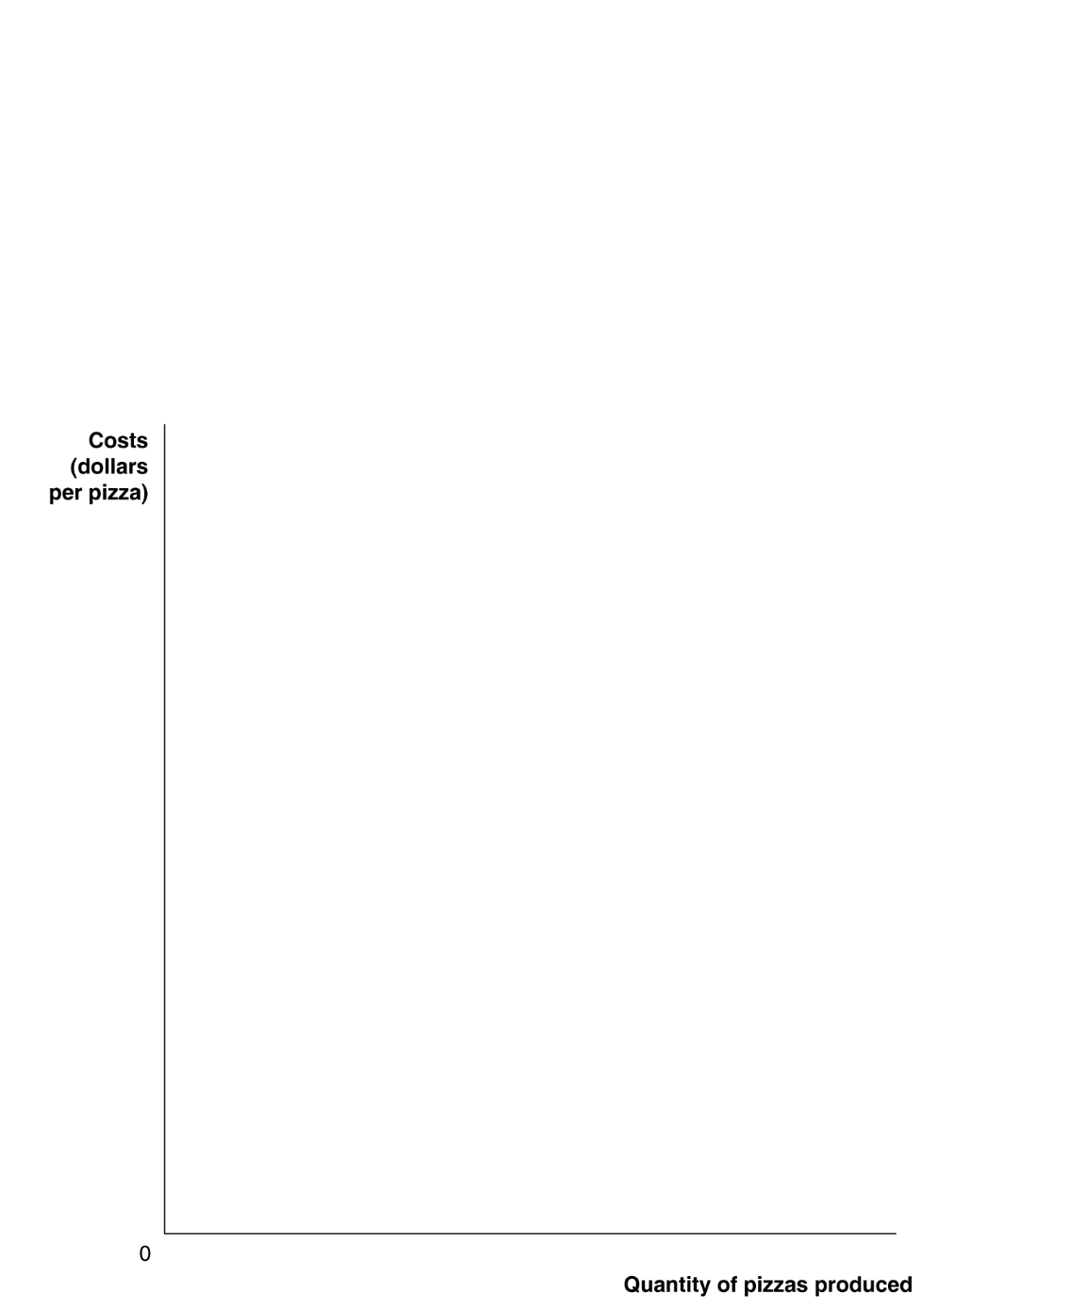







Graphing Cost Curves
Costs at Jill Johnson’s Restaurant

Slide 21
Costs in the Long Run
In the long run, firms have many options available. Examples?
In the long run, there are no fixed inputs – all inputs are variable.
Therefore, all costs are:
As such, a firm has a choice of how large (or small) it should make its size (scale) of operation.
As a firm increases its scale of operation, what happens to its average costs of production?

Slide 22
Possibilities as a firm’s scale of operation increases:
Economies of Scale The situation when a firm’s long-run average costs fall as it increases output.
E.g. Firm doubles its levels of all inputs and output more than doubles.
Constant returns to scale The situation when a firm’s long-run average costs remain unchanged as it increases output.
E.g. Firm doubles its levels of all inputs and output doubles.
Diseconomies of scale The situation when a firm’s long-run average costs rise as the firm increases output.
E.g. Firm doubles its levels of all inputs and output less than doubles.

Slide 23
The Relationship between Short-Run Average Cost and Long-Run Average Cost
Long-run average cost curve A curve showing the lowest cost at which a firm is able to produce a given quantity of output in the long run, when no inputs are fixed.
$
ATC₁
ATC₃
ATC₂
Minimum efficient scale The level of output at which all economies of scale are exhausted.
Quantity

